Slide 1
Knowle CE Primary Academy
Growing in God’s Love; Flourishing Together
Introduction to our curriculum
Year 5
September 2025

Slide 2
Our curriculum is underpinned by the principles of S.M.I.L.E.
Socialise: We connect with the people around us, our families, friends, neighbours and our community. We spend time developing these relationships.
Move: We keep active at school and at home. We aim to pursue physical activity we enjoy.
Interest: We develop our curiosity and ask questions. We aim to notice the beautiful or the unusual.
Learn: We endeavour to keep learning, to try new things or take on new responsibilities. We set ourselves challenges that we will enjoy achieving. We aim to become more confident with each new success.
Engage: We aim to do something nice / give to others. We say ‘Thank you’ and SMILE! We aim to volunteer and give our time, looking out as well as in. We try to make a contribution to the wider life of our school, our family and our community.

Slide 3
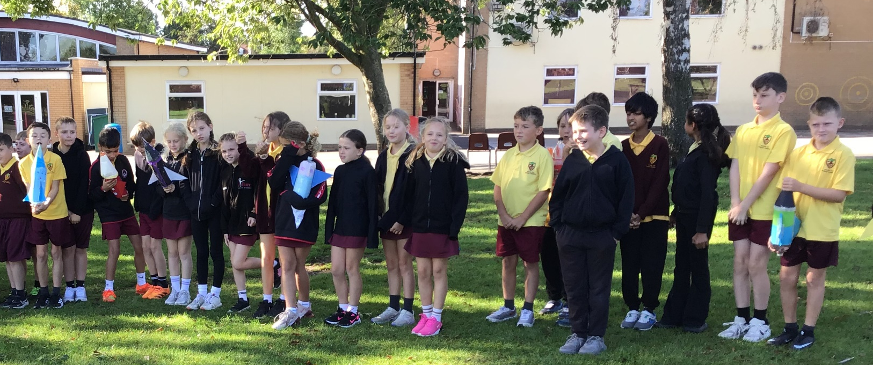
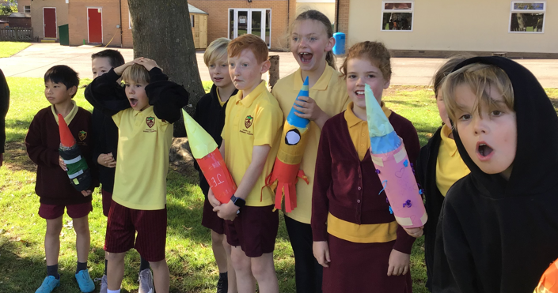
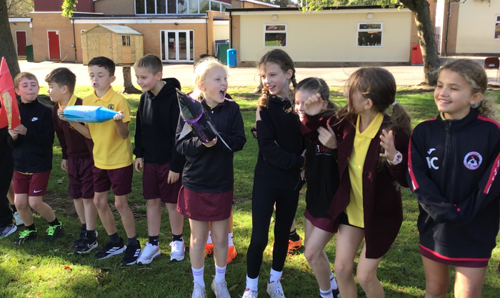
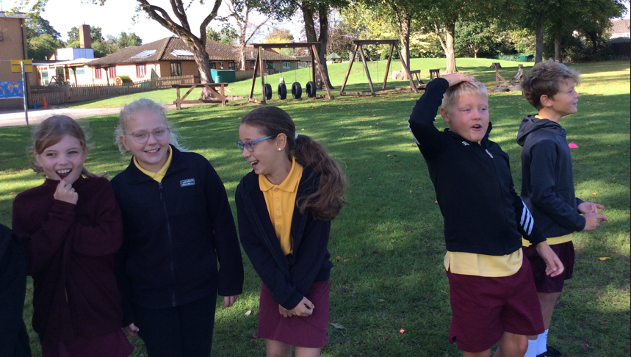

Slide 4
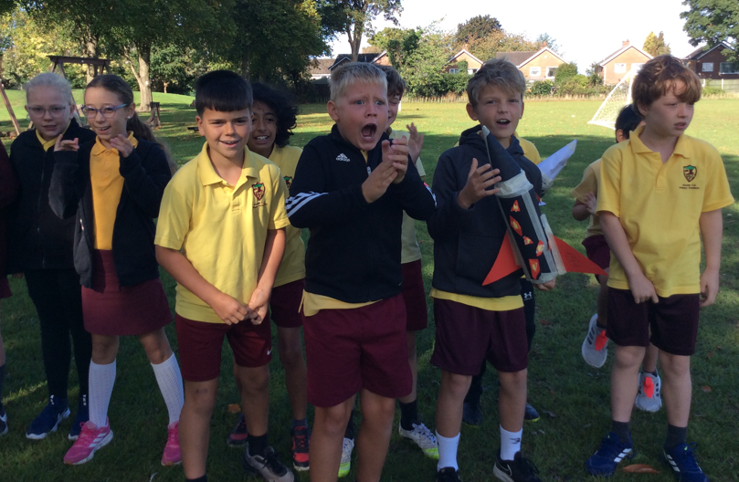
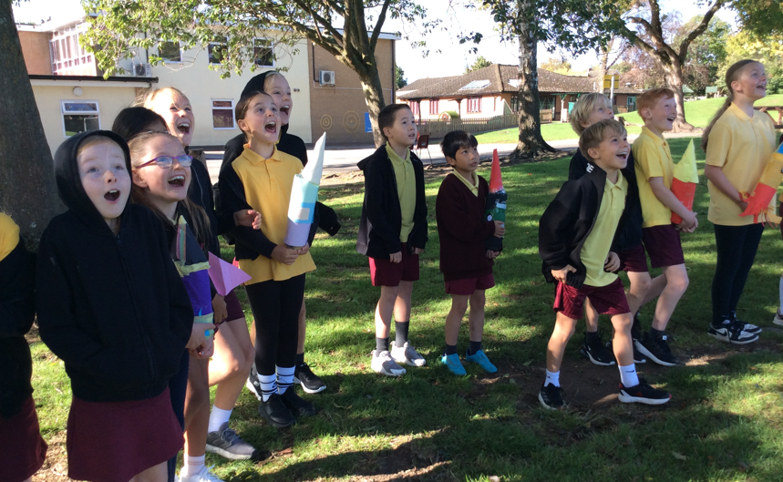
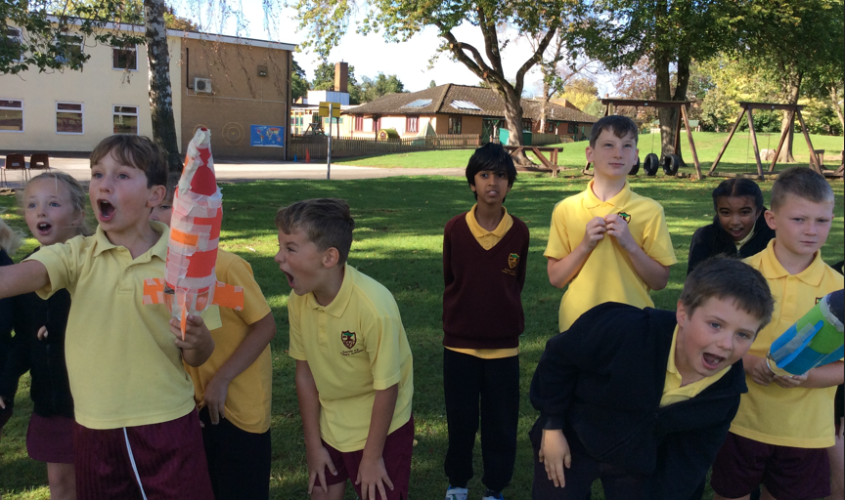
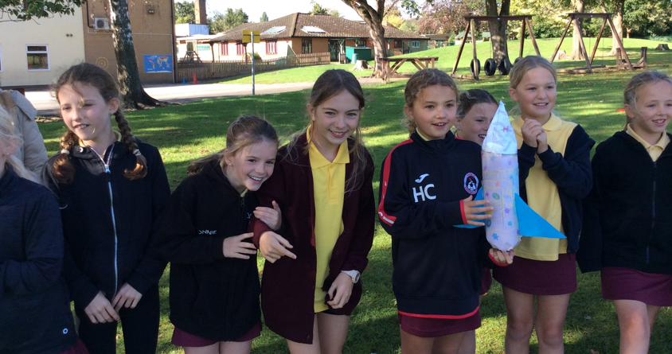

Slide 5

Autumn Term in Year 5 - Part 1
  The theme of the first half of the autumn term is ‘Space’.
  Rocket launch ☺
  In English we study of the book ‘Space Oddity’ – a fast-paced
  adventure which explores the themes of aliens, belonging and
  families, and acts as a stimulus for the children’s writing.
  Our RE lessons look at how creation, as recorded in Genesis 1, fits with scientific discoveries. We ask the question ‘Creation and science – in conflict or complementary’ - and hold a debate with Sarah Covington from KPC and a geologist! – S.M.I.L.E. Socialise
  In our history lessons we consider the question ‘Who really won the space race?’

Slide 6
Autumn Term in Year 5 - Part 1
In science, we study some of the key scientific ideas related to the solar system. Visit to Birmingham Thinktank.
Our PE curriculum covers netball - including the ever-popular Arden Netball Festival – and dodgeball.
Forest School

Slide 7
Autumn Term in Year 5 - Part 2
The theme of the second half of the autumn term is ‘Ancient Greece’.
Our English lessons are centred around the myth of Theseus and the Minotaur – the children invent their own versions of the story.
History – the big question is, ‘In what ways were the ancient Greeks influential?’
Geography – we explore the contrast between ancient and modern Greece.

Slide 8
Autumn Term in Year 5 - Part 2
Computing – using publisher to design webpages for the Greek tourist industry.
Art – sculpting & painting Greek pots.
DT project – cam-based toys – links with Year 1 children

Slide 9
Spirituality
Myself
Others
World / beauty
God / beyond

Slide 10
Spring Term in Year 5
The theme of the spring term is ‘Not So Fast Food’
Geography topic – ‘How can year 5 lead the fight against food waste?’
S.M.I.L.E. - ‘Engage’ - Dinner hall food waste monitors – every child.
Litter pickers.
D & T – Cooking with sustainably-sourced ingredients.

Slide 11
Spring Term in Year 5
English - supported by the book Floodland
Science – Properties of materials
Music – Musical Theatre
Year 5 - Easter Service
PE – Chance To Shine cricket – Festival at K & D cricket club

Slide 12
Summer Term in Year 5
Theme – ‘Where Do We Belong?’
English work is based on 2 books:
  The Island
  Kensuke’s Kingdom
Forest school
  + we write letters to local MPs around the issue of asylum seekers
S.M.I.L.E – Engage – fundraising to support asylum seeking.

Slide 13
Summer Term in Year 5
RE – ‘What does the Qu’ran reveal about Allah and his guidance’ – visit to Islamic Exhibition Centre in Small Heath
Art – graffiti - based on environmental themes
Computing – programming - Marty the robot!

Slide 14
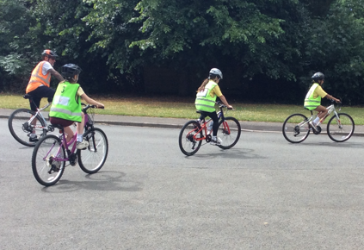
Summer Term in Year 5
Ukulele – concert for parents
Bikeability

Slide 15
Year 5
By the end of the academic year pupils should have:
developed their curiosity and appreciation of the natural beauty of the world they live in and recognised the role they have in protecting it
given their time to work with children from across the school community in order to reduce food waste at school
volunteered and given their time to raise money to support charities linked to refugees

Slide 16
Homework and supporting your children
Homework in Year 5 is set on a Friday
  Spellings
  Reading comprehension
  Maths tasks
Reading diary + new Readopoly sheets
Times Table Rock Stars

Slide 17
Homework and supporting your children
How you can help:
Reading! Read to, read with and hear your child read as well as encouraging independent reading for pleasure –
- this is scientifically proven to have the biggest impact on learning in all areas.
Ensure that your child spends enough time on TTRS and their written homework.
Times tables – practise regularly!

