Slide 1

Parent Curriculum Meeting
Monday 29th September 2025
Year 4

Slide 2
Questions?
Please save these until the end. We will happily answer them then.

Slide 3

SMILE Agenda
Socialise (We connect with the people around us, our families, friends, neighbours and our community. We spend time developing these relationships)

Slide 4
SMILE Agenda
Move (We keep active at school and at home. We aim to pursue physical activity we enjoy)

Slide 5
SMILE Agenda
Interest (We develop our curiosity and ask questions. We aim to notice the beautiful or the unusual. We practice ‘mindfulness’ – being ‘in the moment’, being aware and reflecting on our feelings and experiences)

Slide 6
SMILE Agenda
Learn (Learning is good for us! We endeavour to try new things or take on new responsibilities. We set ourselves challenges that we will enjoy achieving. We aim to become more confident with each new success)

Slide 7
SMILE Agenda
Engage (We aim to do something nice for a friend or a stranger. We say ‘Thank you’ and SMILE! We aim to volunteer and give our time, looking out as well as in. We try to make a contribution to the wider life of our school, our family and our community)

Slide 8

Growing in God’s love; flourishing together.
Our school vision is: 'Growing in God's Love; Flourishing Together'.
At Knowle CE Primary Academy, we provide a nurturing environment for all children and adults to grow in mind, body and spirit, enabling everyone to fulfil their potential. The Fruit of the Spirit are the values we focus on in our every day lives.
Individuals are celebrated for their unique gifts and flourish together through living out our school values, as we make a positive impact on each other, our local community and the wider world.
As a result, children are well-prepared for a future in which they will bear lasting fruit and make the world a better place.

Slide 9
Autumn term: ROMANS
History and Geography focus
A visit from a ‘real’ Roman Centurion for the day, involving role play in a lifelike Roman camp. Participation in traditional Roman games and handling of real Roman historical artefacts; marching and forming a ‘Testudo’ with shields
Making and eating a traditional Celtic vegetable stew
Lead the Harvest Service at school!
Visit from the ‘Foodbank Champion’ from Tesco in Knowle
Collect contributions to be delivered to the Foodbank through KPC
Visit Sparkhill Foodbank

Slide 10
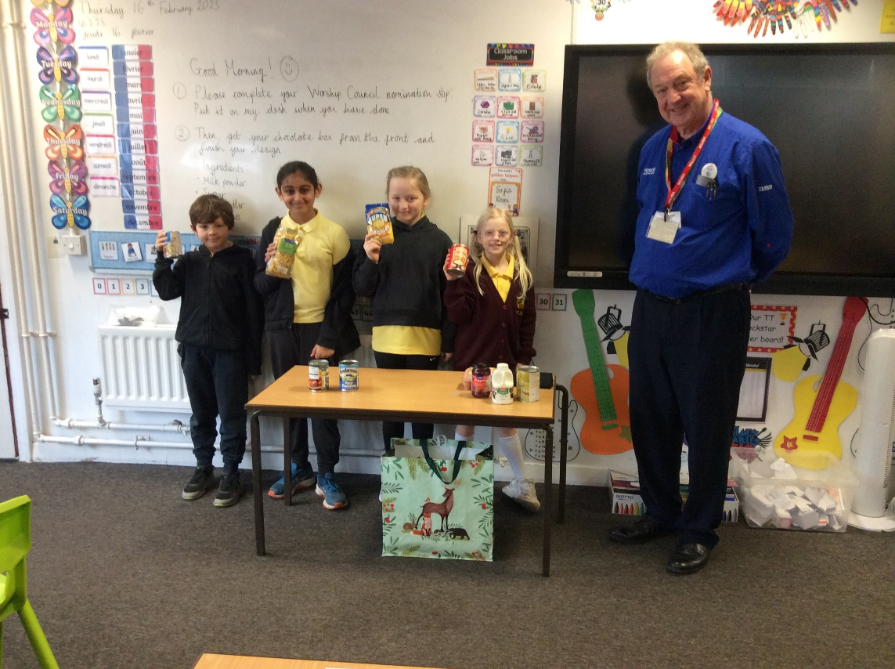
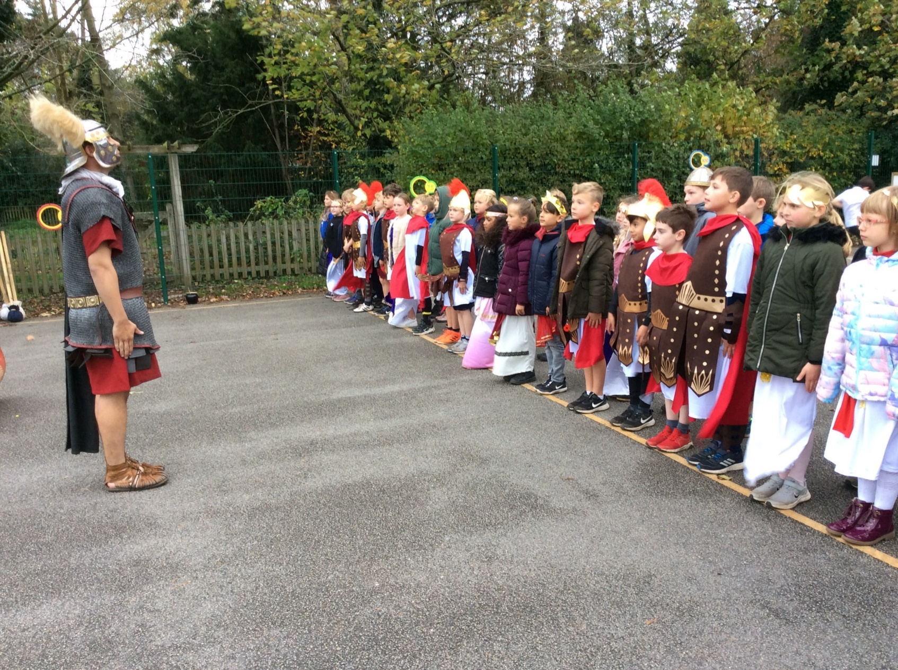
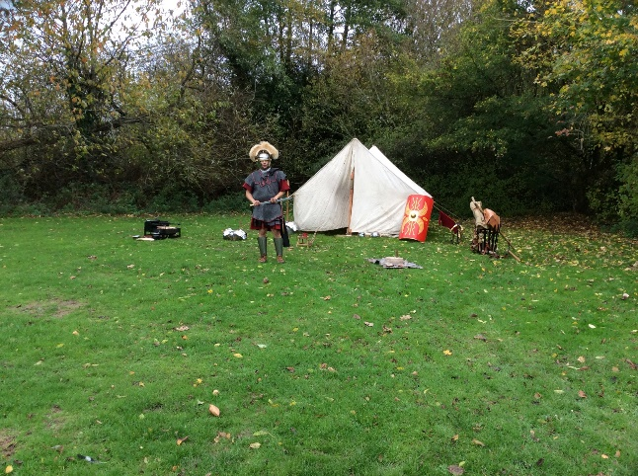
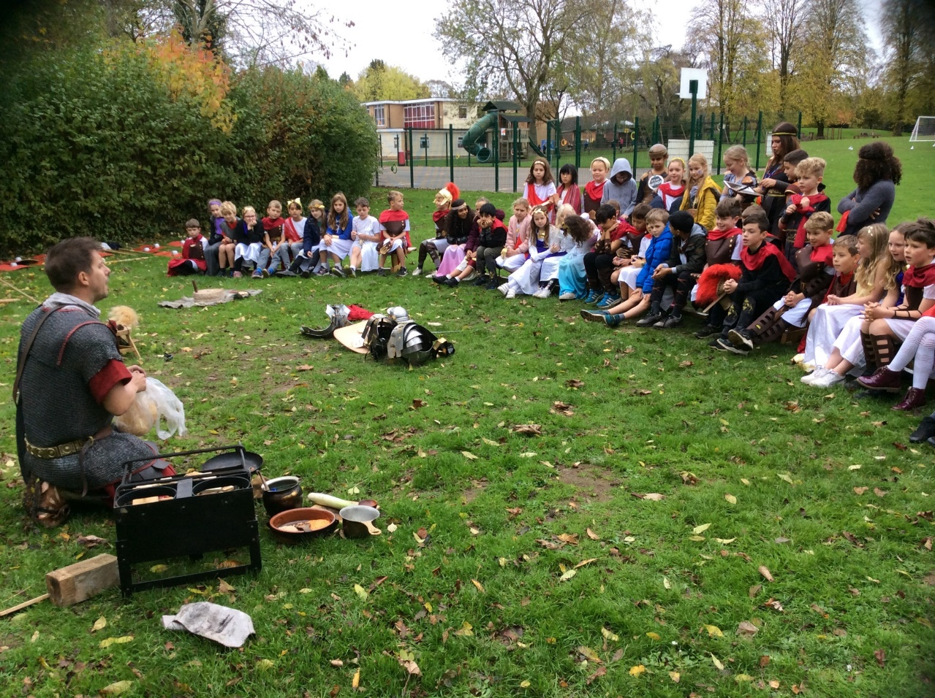
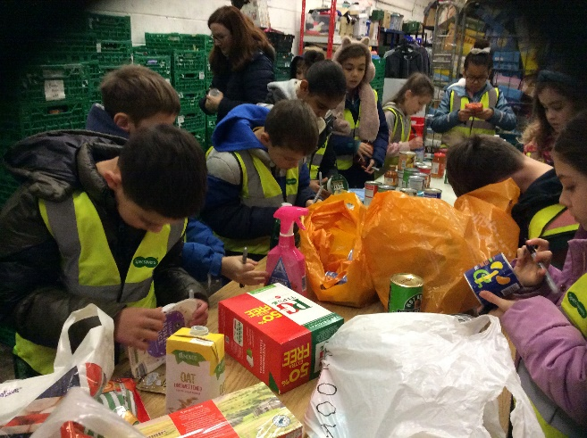

Slide 11
SPRING TERM: CHOCOLATE
Study of George Cadbury and his philanthropy
Chocolate enterprise evening to raise money for Sparkhill Foodbank; create own chocolate bars, adverts and presentations
Every pupil receives a ‘Golden Ticket’ in the post during the Christmas holiday inviting them to a chocolate tasting on the first day back (invited to dress up as a Charlie and the Chocolate Factory character)
A local History visit to Bournville – the ‘Cadbury’ model village. A focus on the study of George Cadbury and his philanthropy, and his Quaker faith.
Continue liaison with Sparkhill Foodbank
Children create Easter Posters to be displayed in Knowle branch of Tesco

Slide 12
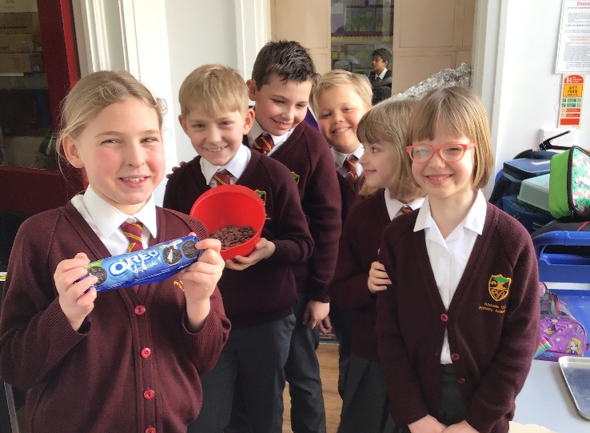
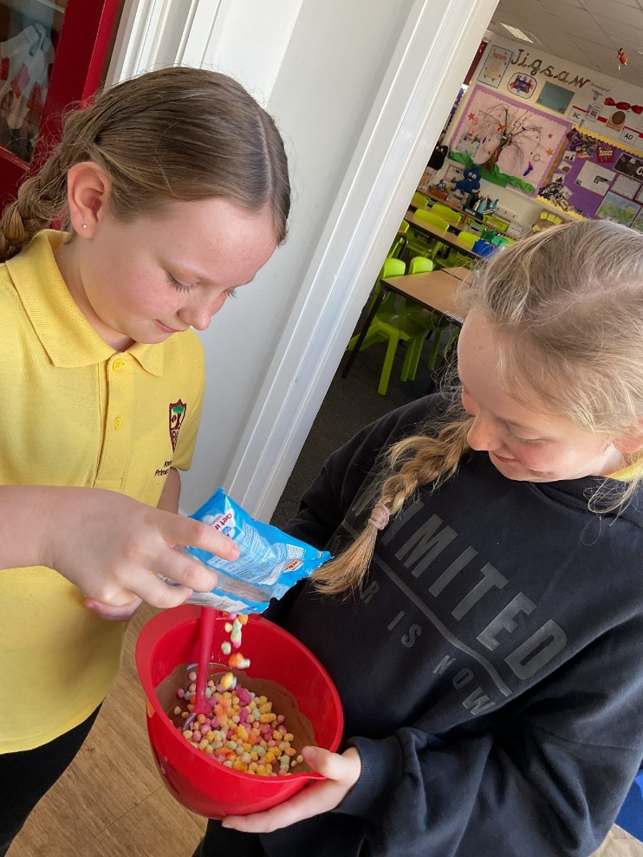
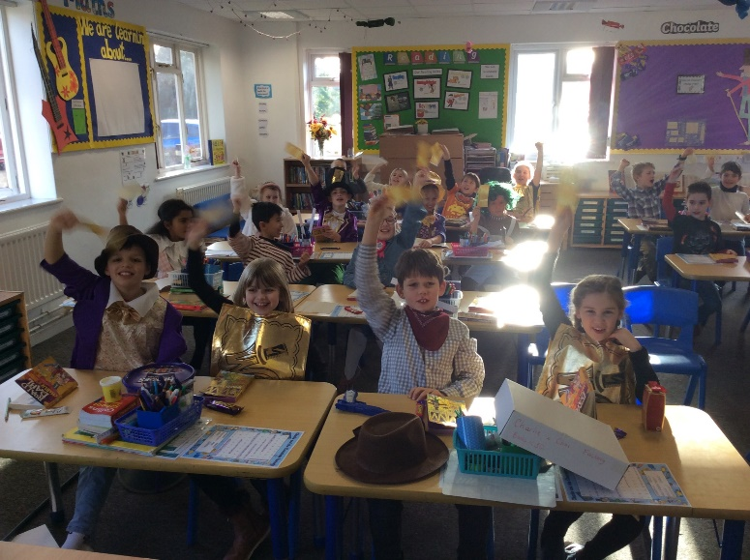
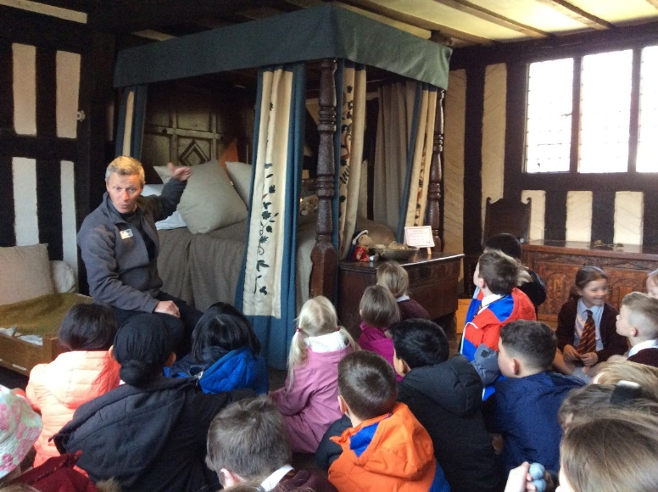
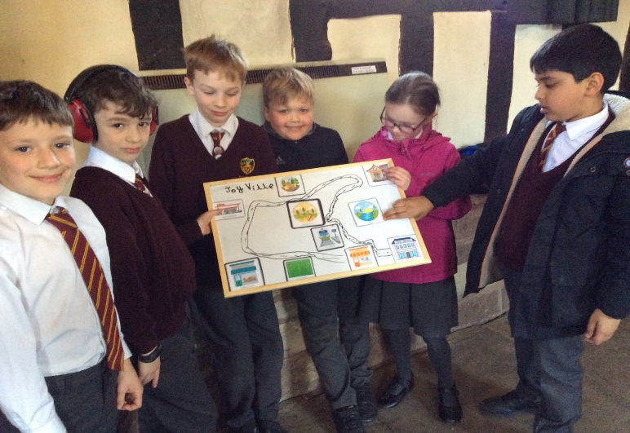
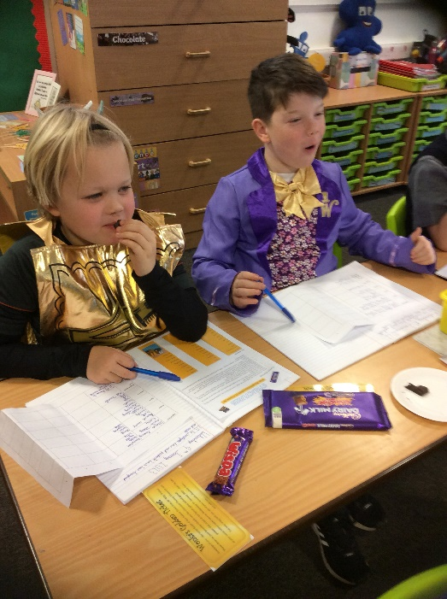
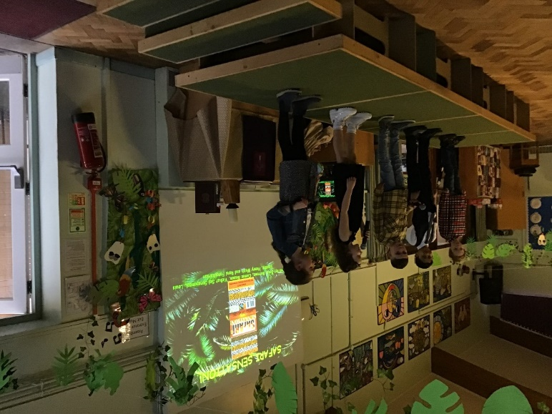
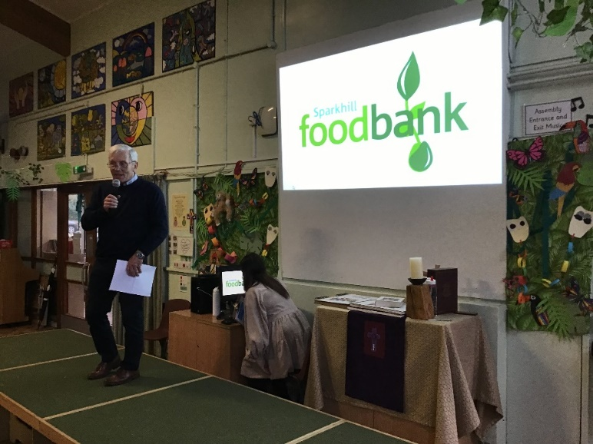

Slide 13
SUMMER term: Innovation
Innovation – inventions and futuristic technology, MakeyMakey projects
Robo workshop where children build electronic robots from Lego and use a coding system to control them.
Showcase event demonstrating our working ‘MakeyMakeys’ during Open Evening
RE - Sikhism
Visit to the Sikh Gurdwara in Leamington and participation in ‘Langar’ (free kitchen for the community)

Slide 14
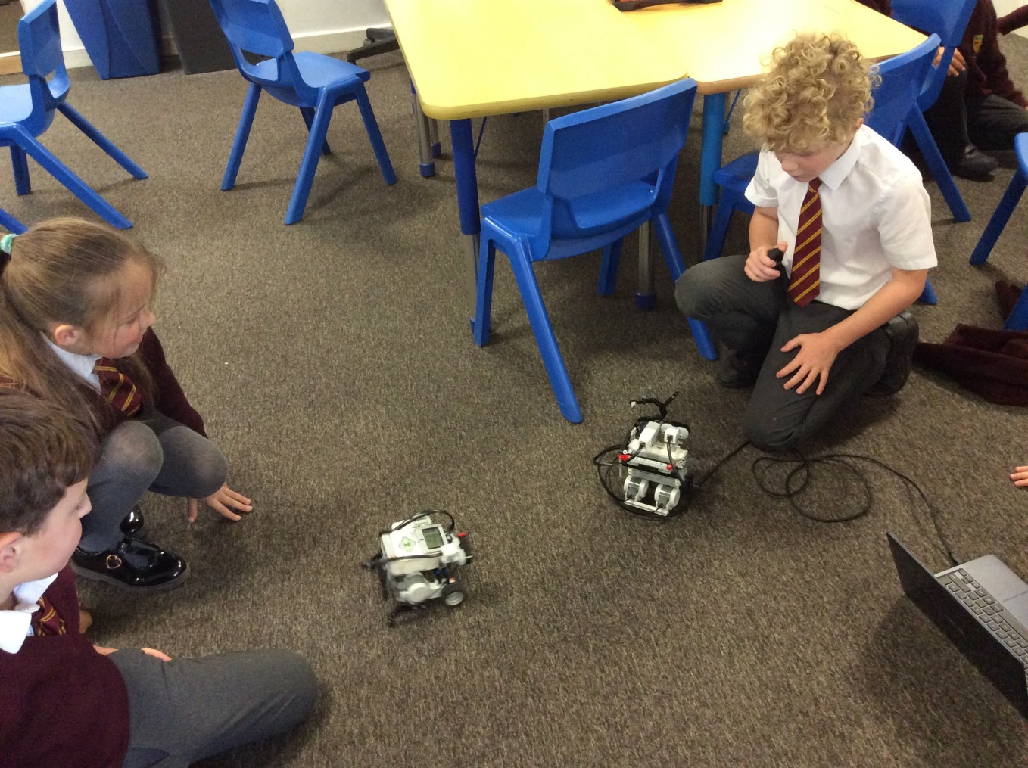
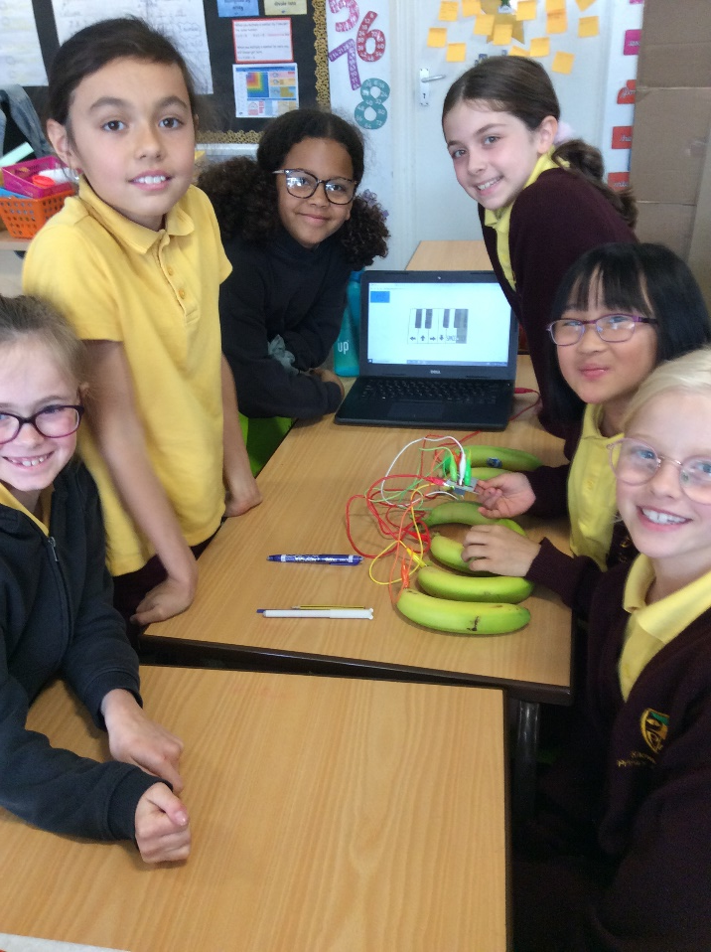
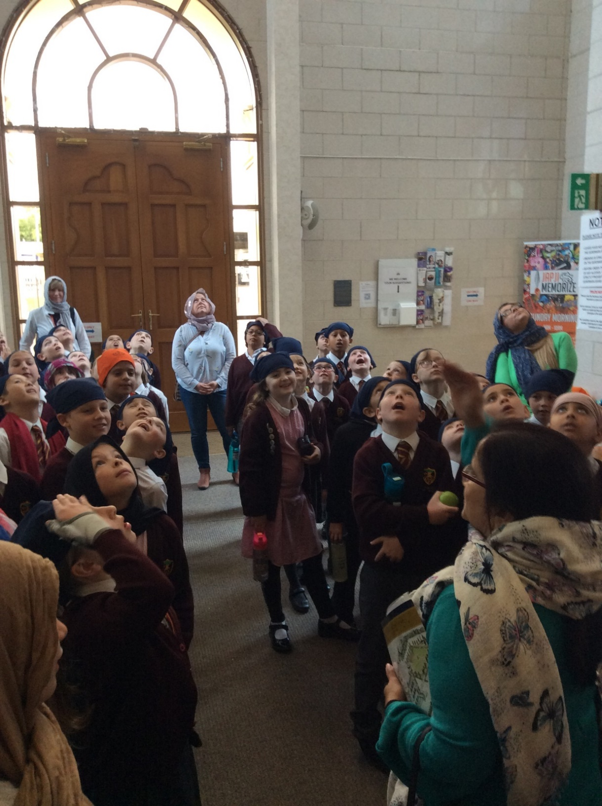
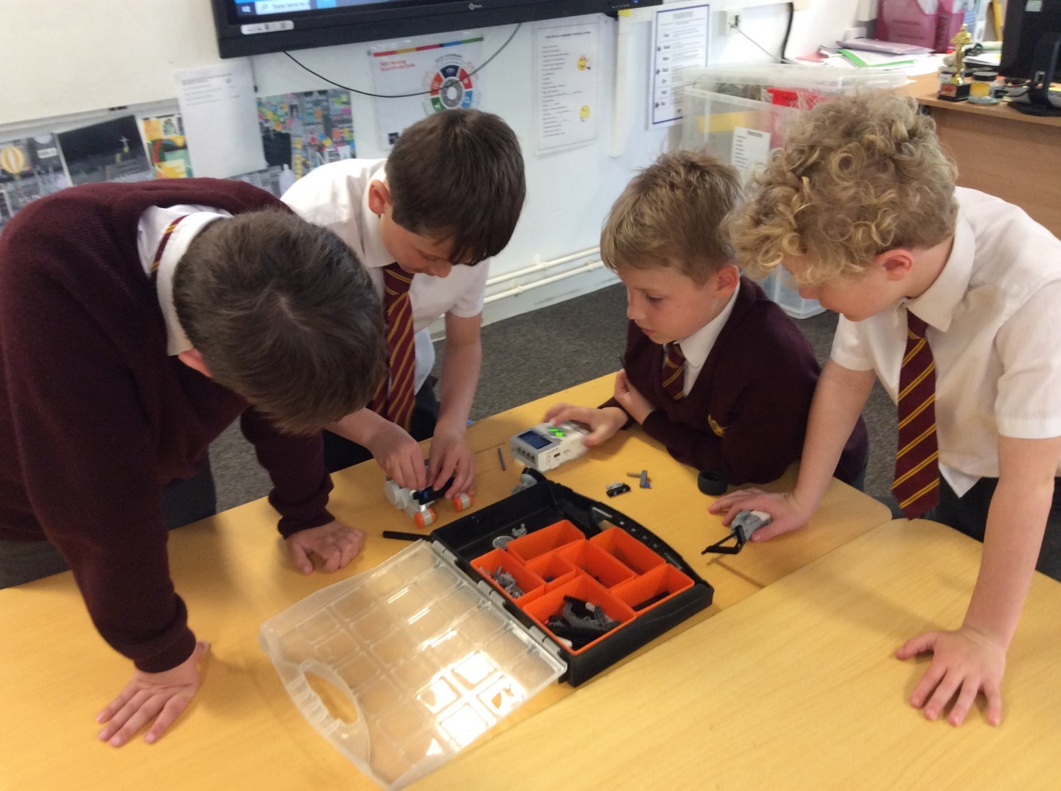
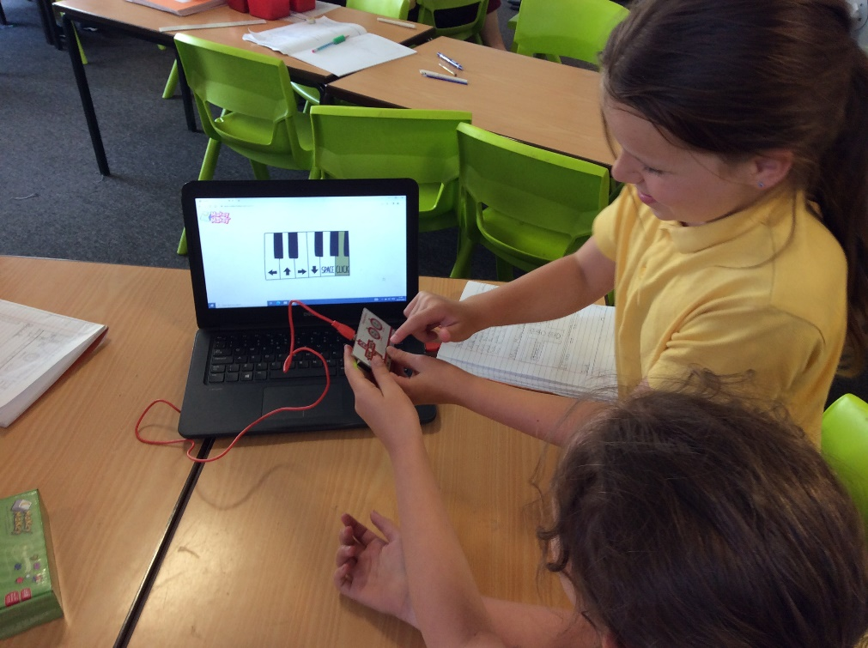

Slide 15
Organisation of teaching
Mrs Shaw, Mrs Parker - class teachers
Support from Mrs Eades, Mrs Hart, Mrs Qureshi and Miss Stubbs.

Slide 16
Homework, including reading
Set and checked on Friday
* Maths
* Reading
* TT Rockstars
* Spellings
Usually self-marked

Slide 17
Reading diaries
Daily reading should be noted in diary and one weekly ‘Bingo’ task completed as part of homework. When sheet is complete, same tasks again based on more challenging books. Please find attached strategies to support your child with reading development at home.
Certificates are awarded every other week in Celebration Assembly.
Also as part of homework, one reading comprehension is set based around First News children’s newspaper.

Slide 18
TT Rockstars
These are particularly important this year – Official Multiplication Tables Check in June.
Children have 25 TT questions to answer. This will be in small groups taking place in the Media Suite (practice run first).
Further information closer to the time to follow.
The expectation is that all children know times tables up to 12x12 by end of year.
We include TT activities and support groups within school timetable. Along with the homework, a Maths activity is set based on the week’s learning.

Slide 19
Questions?

