Slide 1


Parent Curriculum Meeting
23rd September 2025
Year 2

Slide 2
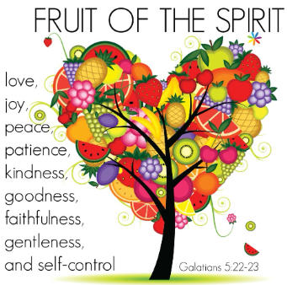
Growing in God’s love; flourishing together.
Our school vision is: 'Growing in God's Love; Flourishing Together'.
At Knowle CE Primary Academy, we provide a nurturing environment for all children and adults to grow in mind, body and spirit, enabling everyone to fulfil their potential. The Fruit of the Spirit are the values we focus on in our everyday lives.
Individuals are celebrated for their unique gifts and flourish together through living out our school values, as we make a positive impact on each other, our local community and the wider world.
As a result, children are well-prepared for a future in which they will bear lasting fruit and make the world a better place.

Slide 3

Organisation of teaching
Class teachers
Mrs Palmer 2P
Mrs Hawkins 2H
Support from Mrs Wilson and Mrs Randell
1:1 support from Miss Thompson and Mrs Jones
Mrs Wilson (2H on Thursday afternoons)
Mrs Ingram (2P all day Wednesday and Thursday afternoon)

Slide 4
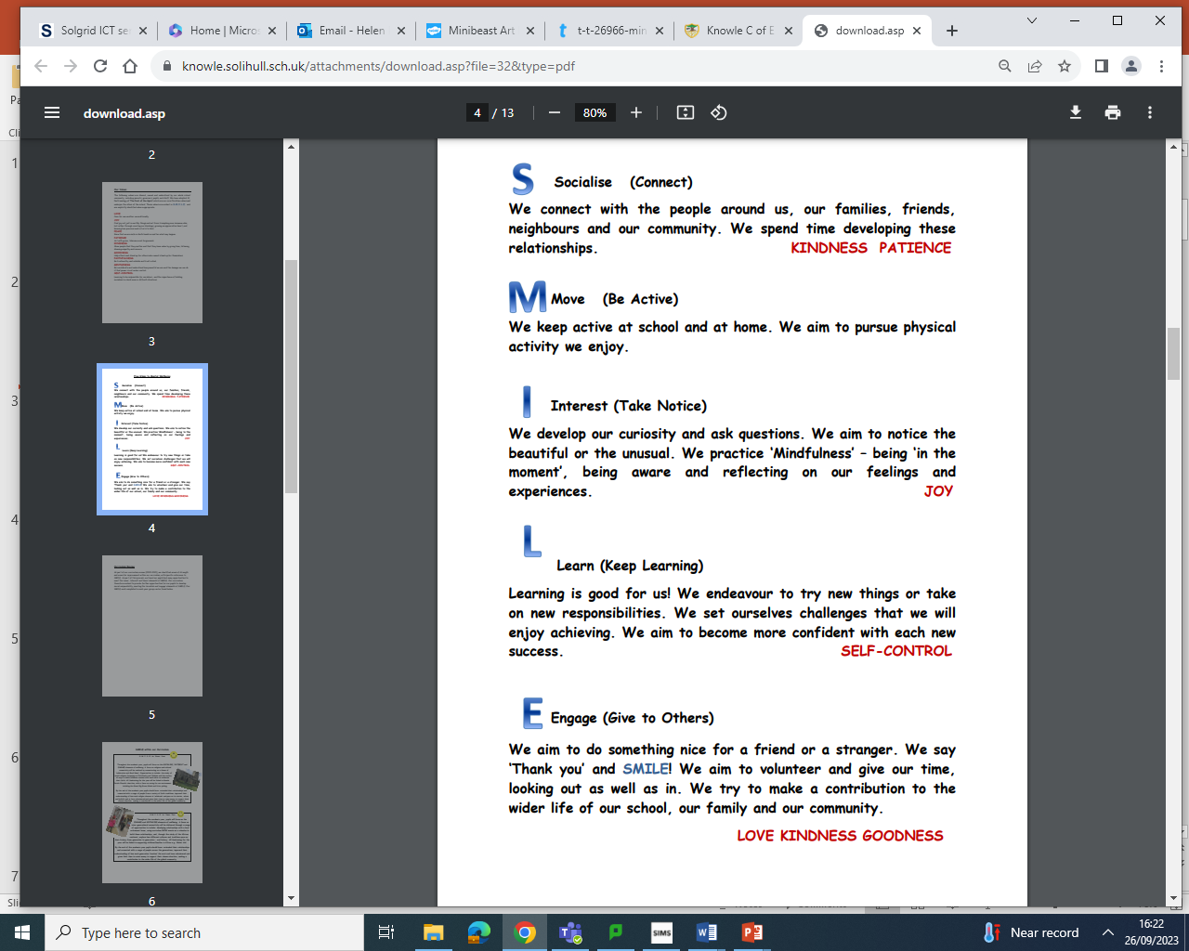
SMILE Agenda

Slide 5
OUR YEAR 2 SMILE Agenda
Throughout the academic year, pupils will focus on the ENGAGE and SOCIALISE elements of wellbeing. A focus on inter-generational connectivity will be delivered through a range of opportunities to include: developing relationships with a local retirement home, using curriculum WOW events as a stimulus to build these relationships, and, through the study of the African continent, explore how different cultures and traditions pass on their history from generation to generation – oral history. All fundraising for the year will be linked to supporting children/families in Africa (potential link with a school in Milawi through the church)
By the end of the academic year pupils should have: extended their relationships and connected with a range of people across the generations; improved their understanding of how each generation ‘teaches’ the next and have volunteered and given their time to raise money to support their chosen charities, making a contribution to the wider life of the global community.

Slide 6
Events and celebrations in year 2
Visit to a retirement home to deliver personalised Christmas Cards and Carol Singing
Christmas Panto Visit
Multi-skills festival
An African Drumming Workshop
Africa celebration for Parents – serving food made in D & T and showcasing our work: 24th March 2.45pm
Visit to an African village (West Midlands Safari Park)
Visit to Knowle Parish Church
The Iron Man making
Victorian Day – very strict teachers and lots of rules and handwriting practice on a chalkboard
Visit from a member of the Muslim faith (parent invited)
Kick Rounders Festival at Arden
Summer Entertainment Production 7th and 9th July 2pm

Slide 7
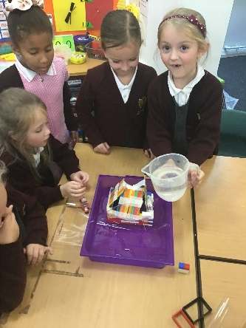
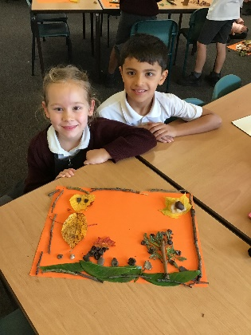
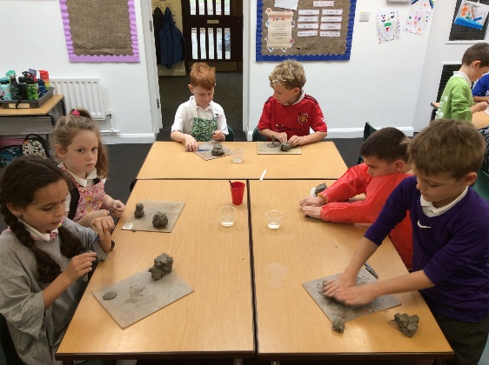
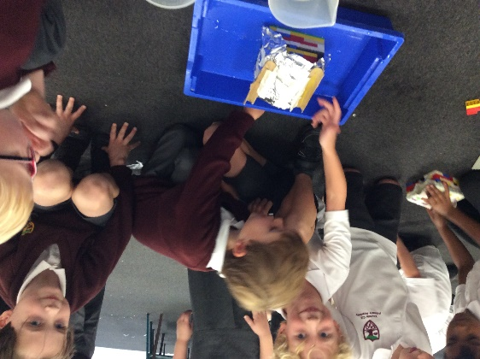
YEAR 2 CURRICULUM
MARVELLOUS MATERIALS
This unit is driven by the Science curriculum focussing on materials. Pupils select and use a range of tools and equipment to design a house for ‘The Three Little Wolves and The Big Bad Pig’. Children investigate natural materials, clay models and collage.
AMAZING ANIMALS!
This unit is driven by the Science curriculum focussing on Living Things. The text used to support this unit will be ‘The Bear under the Stairs’ by Helen Cooper.

Slide 8
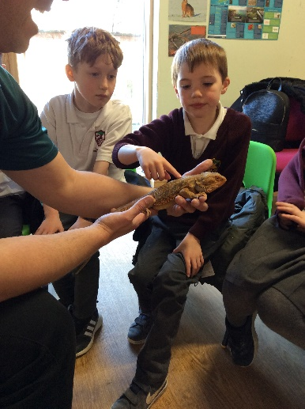
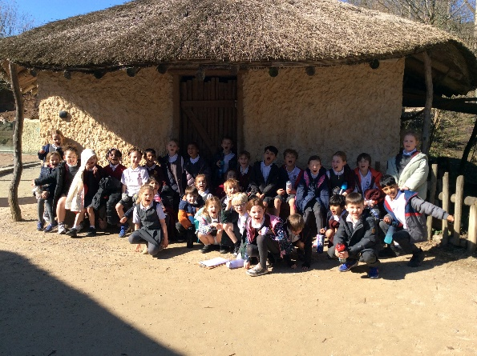
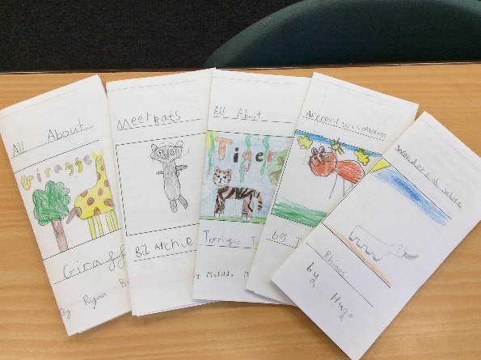
YEAR 2 CURRICULUM
THE AFRICAN ADVENTURE
Pupils’ learning focuses on the exploration of Africa. During geographical study, pupils learn about map reading, location of the continent and the variety of countries which make up Africa; they make comparisons between Knowle and the Masai. They create African inspired art using a range of techniques and materials. Pupils read ‘Meerkat Mail’ by Emily Gravett, ‘Tadpole’s Promise’ by Jeannie Baker and ‘Yeti and the Bird’ by Nadia Shereen to support their own writing development and study animals found in African countries.

Slide 9
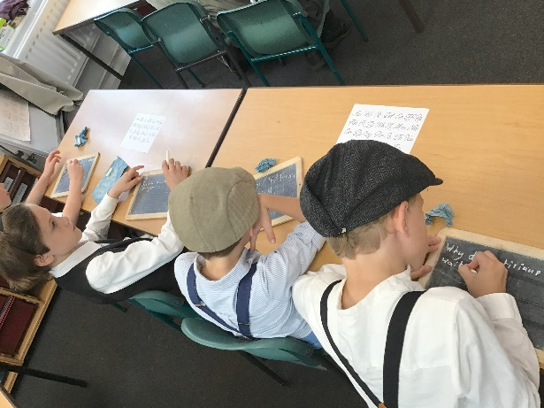
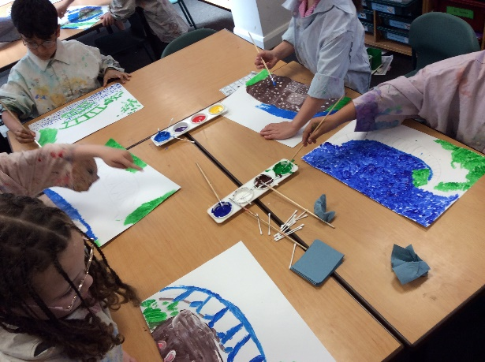
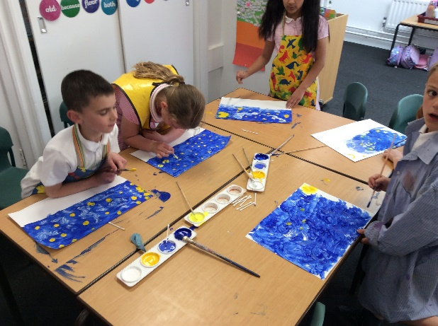
YEAR 2 CURRICULUM
BLAST FROM THE PAST
The final term in Year 2 has a History curriculum focus which looks primarily at the Victorians. The era is explored from a variety of perspectives including childhood and school, health care (or the lack of it) and the work of Florence Nightingale. Pupils explore the work of George Stevenson and his contribution to train travel.

Slide 10
Why is reading so important?
It encourages language development
Fuels imagination, creativity and inquisitiveness
Improves academic achievement in all areas by improving cognitive development over time
Provides some tranquility in increasingly hectic days
Please ensure books are in the book bags and write in their reading records.
Notes:
So why is reading so important?

Slide 11
Reading Fluency (Speed):
We will be focussing on fluency and pace.
Target for every child by the end of the year:
To be able to read 90 words per minute (or more) of an age-appropriate text.
Notes:
As far as lower juniors are concerned, the stripped-down expectations of what a reader should be able to do are as such. However, this is exactly the same for all year groups (age-appropriate texts) but the green strands tend to appear more than the orange ones as children et older or more proficient. Most of this can be summarised into reads most words by sight so can understand what is being read and then is able to ‘read’ unfamiliar words using phonics, morphology (bits of words) and working out what the word means using what is going on around it. It’s exactly the same in Year 6 but the words tend to be more advanced.

Slide 12
the 6 p’s
What does fluent reading look like?
To help learners focus on their reading fluency, various aspects of reading aloud have been separated into six key elements. Each aspect works in partnership with the others to produce a rich and vibrant reading performance:
Pitch: The musicality of the reading voice – including tone and intonation.
Power: The strength given to the reading voice – including volume and stress.
Pace: The speed and rhythm at which we read.
Punctuation: The adherence to and understanding of the marks an author has placed upon the page.
Pause: The knowing of when not to read and for how long.
Passion: The emotion of the reading – including empathy and sympathy and the development of a reader’s love for the written word.

Slide 13
Writing in Year 2
In Year 2, we have lots of wonderful opportunities for children to develop their writing skills throughout the year.
In order to this, we have ensured that the writing is purposeful and directed towards a specific audience to make it more real and meaningful for the children.

Slide 14
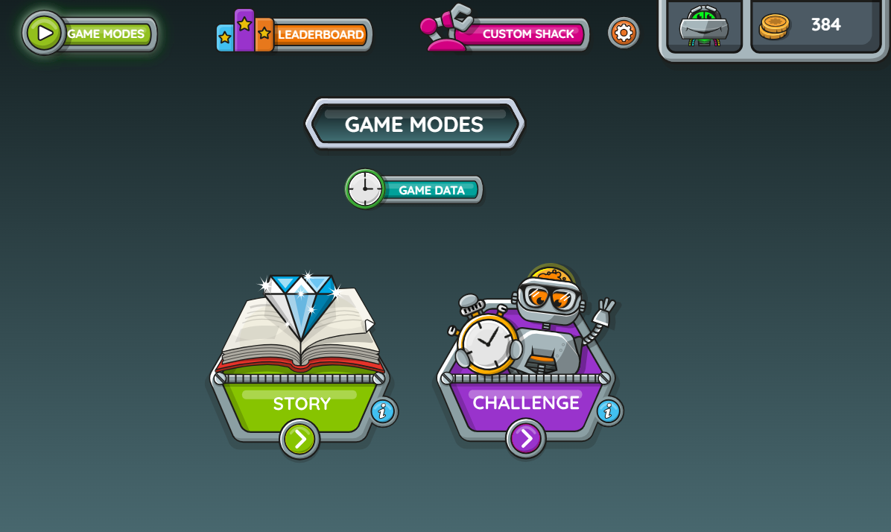
Numbots autumn term
Numbots- A school incentive from Year R- Year 2.
Children will have access to practise their instant recall of number facts.
15 mins per week online as part of homework to secure number facts and understanding.
Letter to be sent with homework.

Slide 15
TT ROCKSTARS sUMMER term
TT Rockstars! A school incentive from Year 2 – 6.
Children will have access to practise the 2, 3, 5 and 10 times tables.
Activities will take place in school using TTRockstars throughout the week.
3 minutes to complete 60 questions.
15 mins per week online.
This will start in the Summer term.

Slide 16
KS1 SATS
KS1 SATs are no longer compulsory.
At Knowle we will still be completing the SATS assessments in the Summer term.
These are to aid teacher’s assessments but the main assessment is based in teacher judgement (if we know your child can do something in class).
The SATs are useful to expose children to this type of assessment.
Children will get lots of practise throughout the year.
They are administered very informally and we call them ‘booklets’ with the children.

Slide 17
ROUTINES IN SCHOOL
Homework – Due in Wednesday, new homework sent home on a Friday
Library – Monday
Book change – Monday
Spelling Test – Monday
2P PE –Tuesday and Friday
2H PE – Wednesday and Friday

Slide 18
REMINDERS
Be Ready, Be Respectful, Be Safe
Reading diaries to be signed weekly and in book bags daily.
No football card allowed in school.
Ensure your child only has a small keyring and no Labubu keyrings as they do not fit into trays.
Please do not send your child in with laced shoes if they cannot do their laces up on their own.

Slide 19


