Slide 1
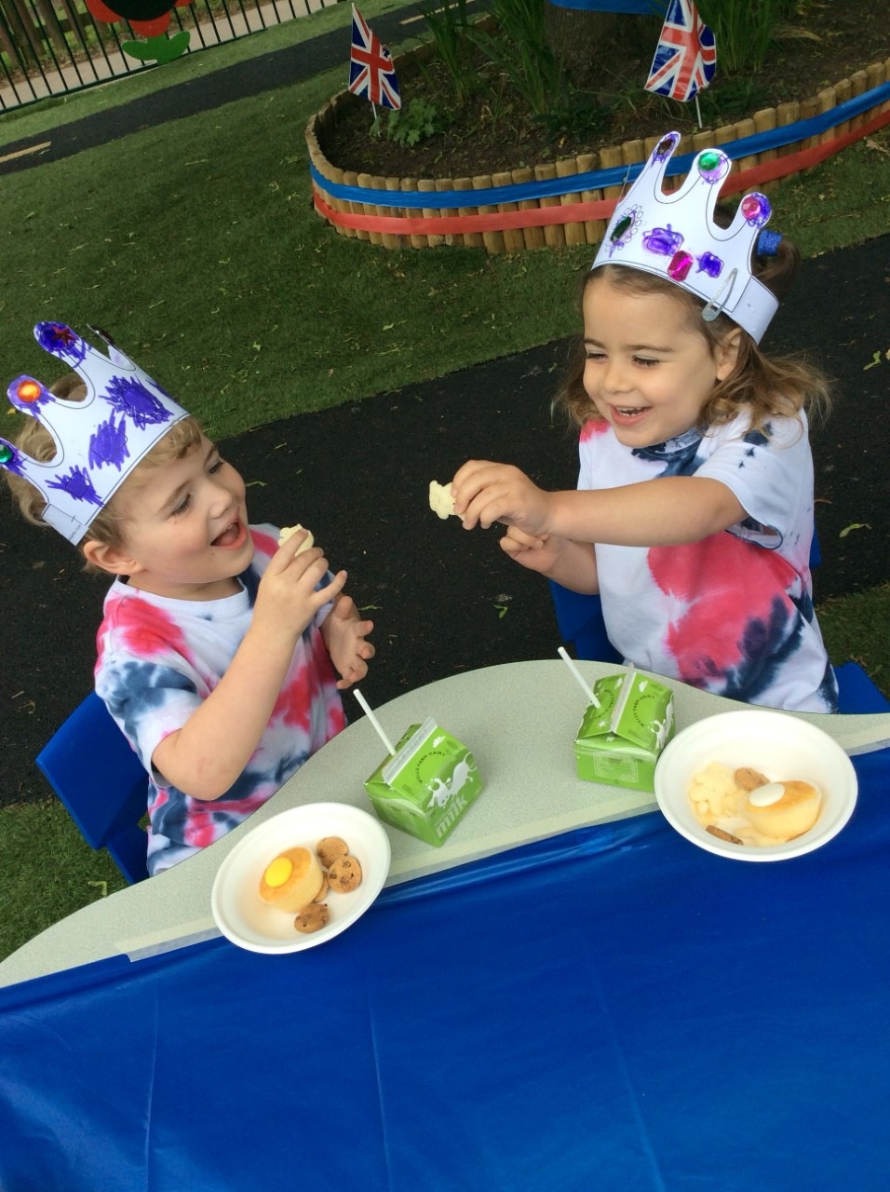
An introduction to Nursery
03.10.24

Slide 2

Our Christian Vision
Growing in God’s Love; Flourishing Together
At Knowle CE Primary Academy, we provide a nurturing environment for all children and adults to grow in mind, body and spirit, enabling everyone to fulfil their potential. Individuals are celebrated for their unique gifts and flourish together through living out our school values, as we make a positive impact on each other, our local community and the wider world. As a result, children are well prepared for a future in which they will bear lasting fruit and make the world a better place.

Slide 3
S.M.I.L.E Agenda
S.M.I.L.E Throughout the academic year, pupils will focus on the SOCIALISE, MOVE, INTEREST, LEARN and ENGAGE elements of wellbeing. During our time in Nursery, we develop positive relationships with both adults and our peers. These warm, caring, and consistent relationships help us to feel safe and secure and provide us with the opportunity to develop our sense of self, feeling valued and understood.
We begin to understand how we can manage our emotions, set ourselves simple goals and gain confidence in our own abilities. We learn through rich opportunities both inside and outside the classroom where we explore, investigate, and discover. These memorable learning experiences promote creativity, independence and most importantly enjoyment!
By the end of the academic year pupils should have: gained a strong sense of self and belonging to our ‘Nursery Family.’ Pupils will begin to understand the wider community to which they belong to and understand ways they can give to others and nurture their relationships. Pupils begin to move from the ‘I’ to the ‘We’ and are prepared for their next stage of their journey into Reception.

Slide 4
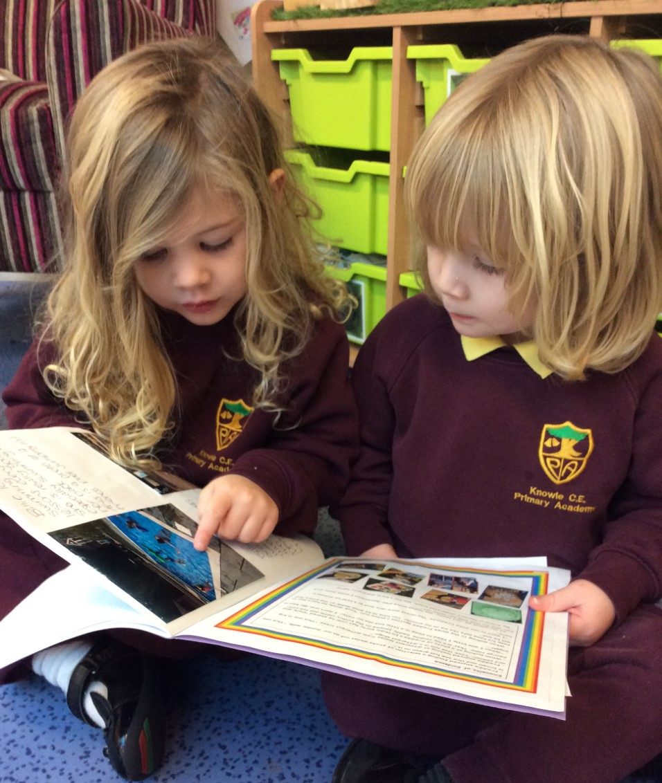
What is the EYFS?
The Early Years Foundation Stage (EYFS) covers the first stage of a child’s care from birth to five years old. It sets the standards to ensure that all children learn and develop, as well as keep them healthy and safe.
EYFS is split over two academic years. The first year in Nursery focuses on the new Department for Education framework, ‘Development Matters’, which is non statutory.
In the second year in Reception we focus on working towards the Early Learning Goals and this is a statutory requirement.

Slide 5
The Early Years Foundation Stage
The Early Years framework includes seven areas of learning and development.
The 3 prime areas are crucial for igniting children’s curiosity and enthusiasm for learning.
Communication and Language
Personal, Social and Emotional Development
Physical Development
The prime areas are strengthened and applied through the 4 specific areas:
Literacy
Mathematics
Understanding the World
Expressive Arts and Design

Slide 6
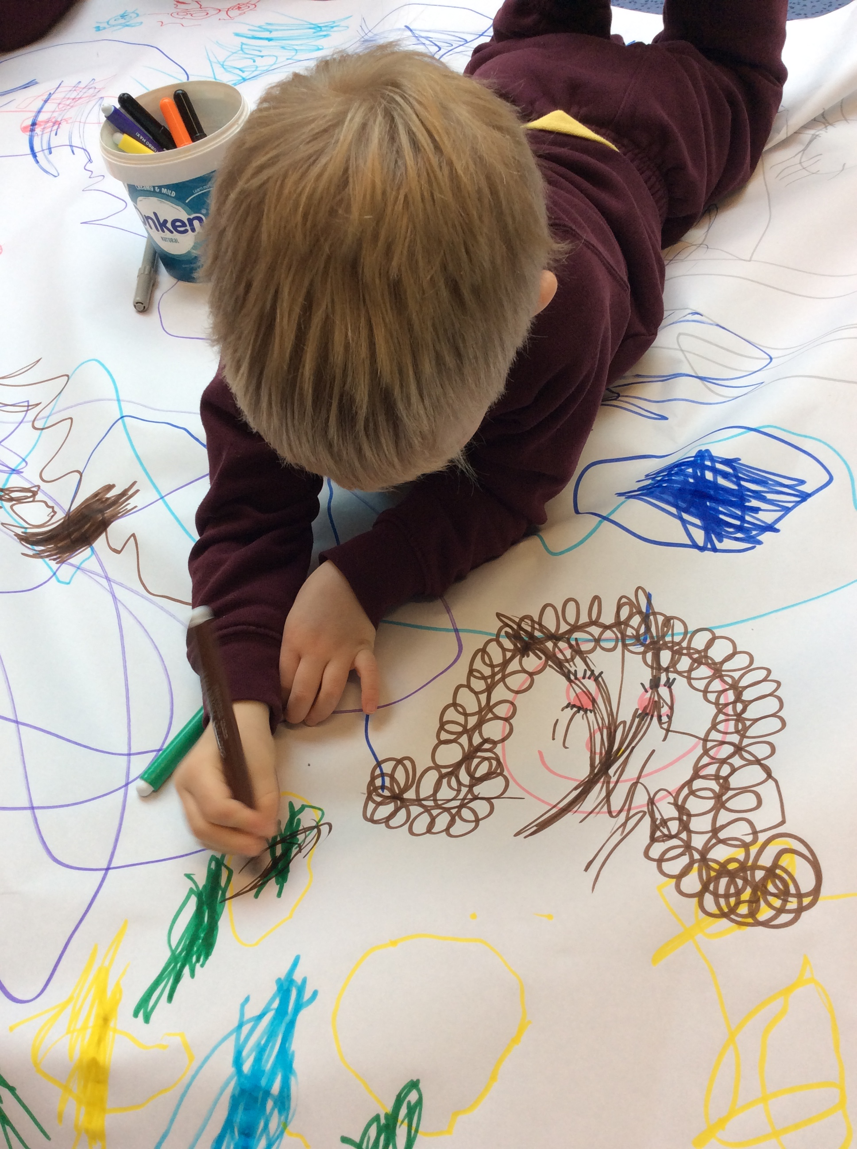
Children’s Development ~ Nursery
Children develop and learn at different rates and in different ways. Their development is not neat and orderly. That is why the ‘Development Matters’ sets out children’s learning into age bands.
The focus age bands for Nursery are:
Birth to three
3 and 4 year olds
The expectation is that by the end of Nursery your child should be working securely within the 3 and 4 year old band in preparation for Reception.

Slide 7
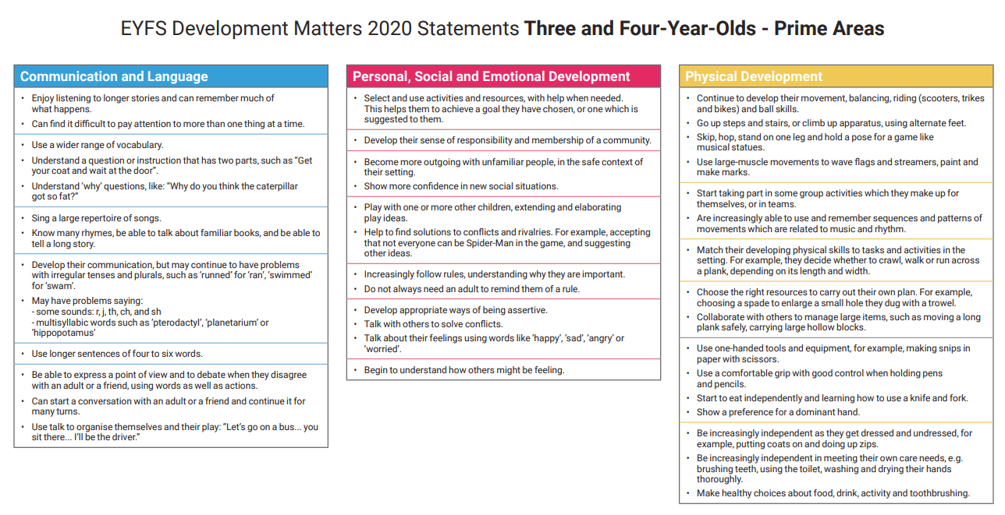

Slide 8
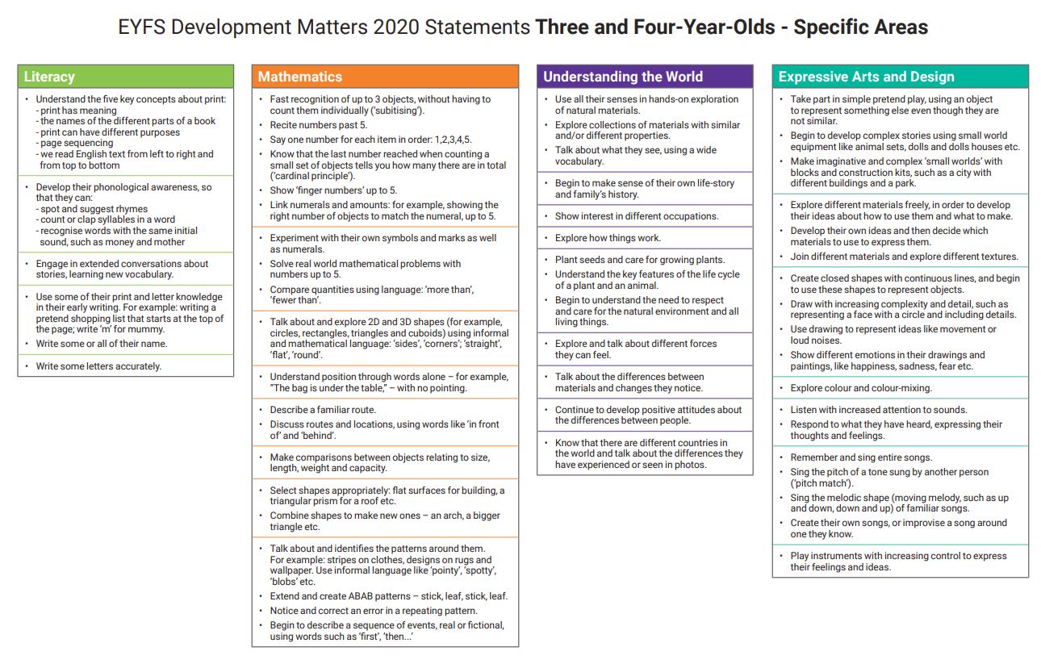

Slide 9
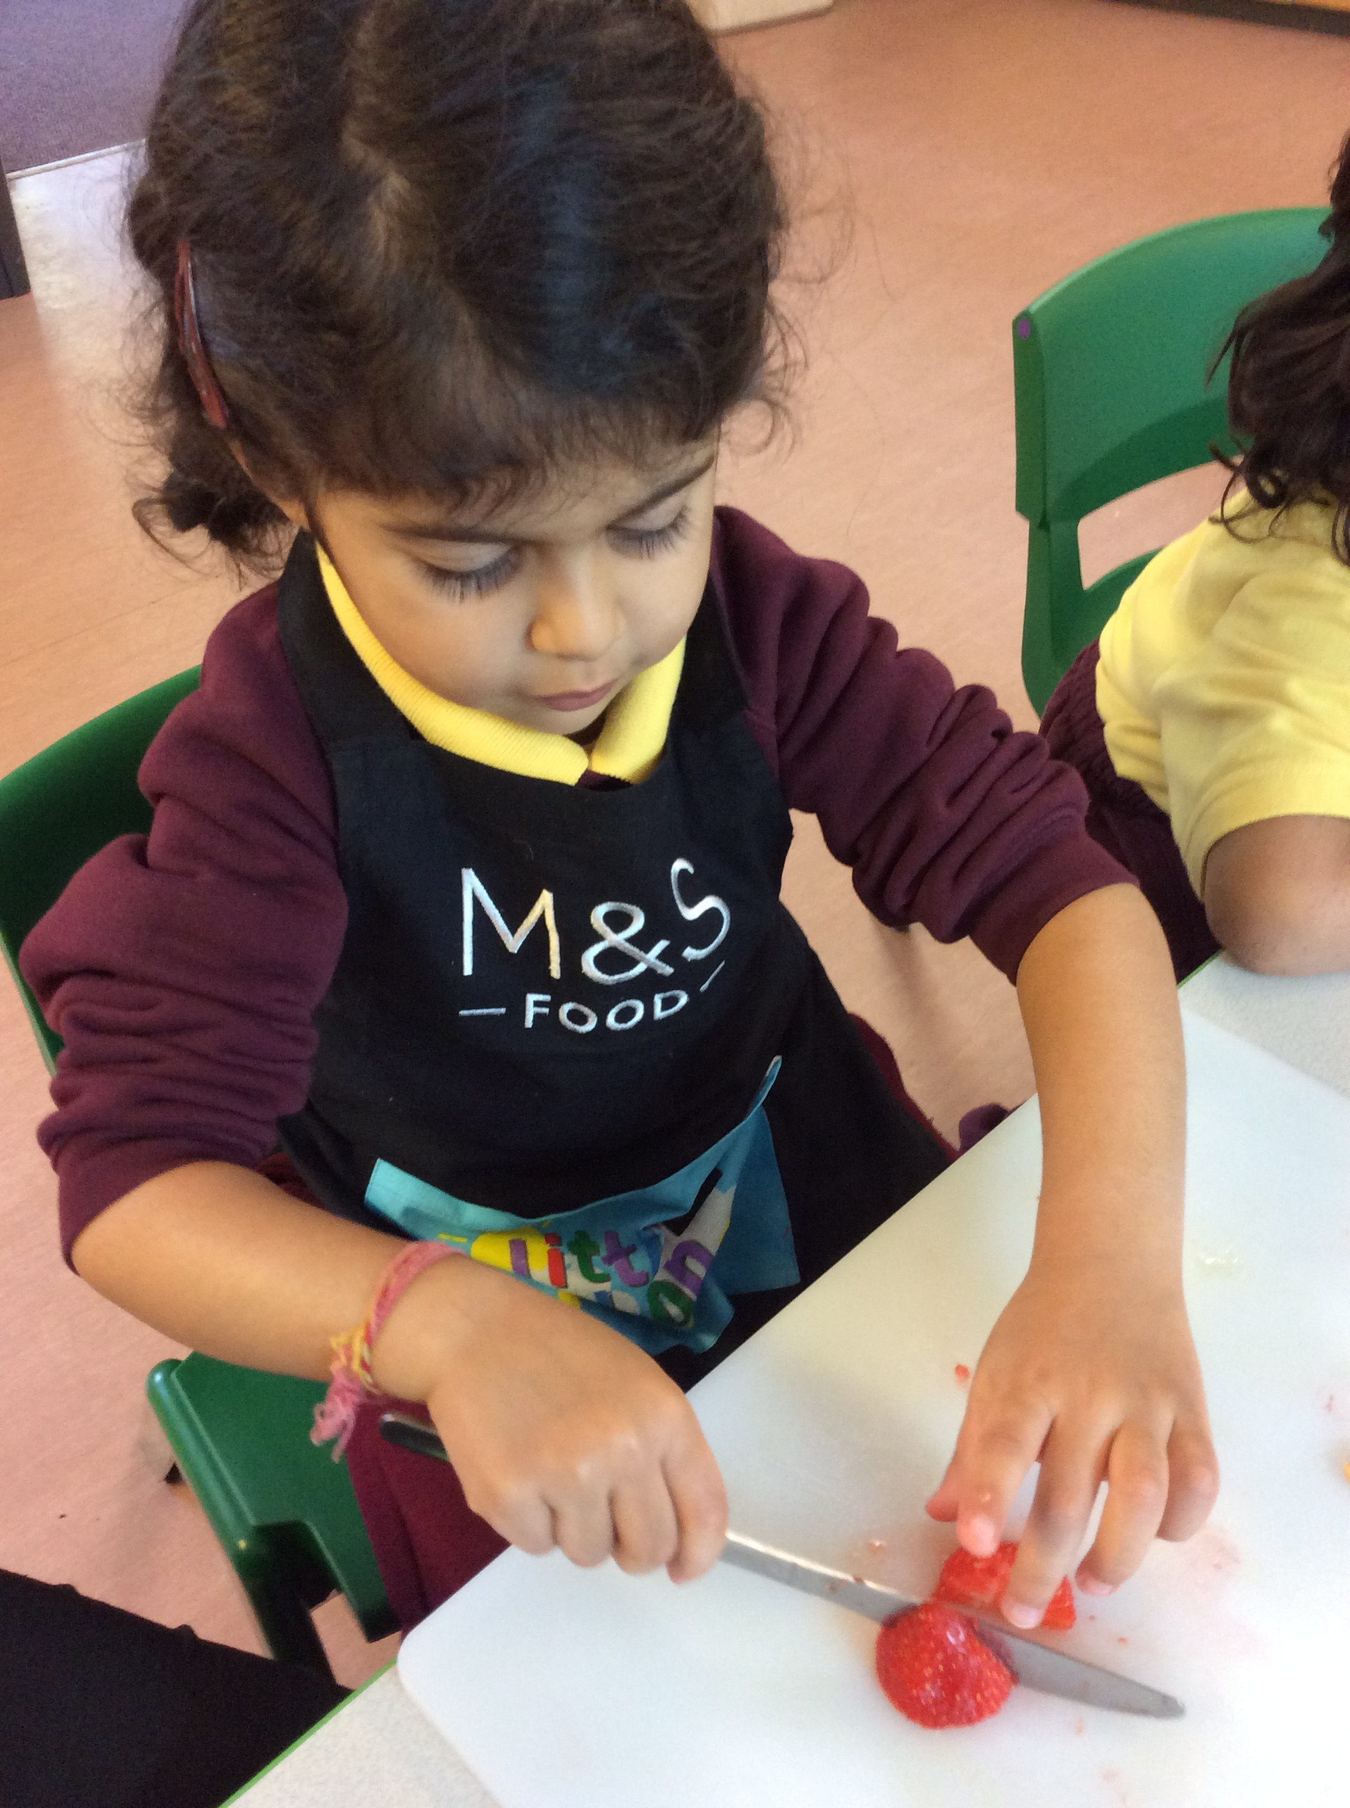
EYFS Provision
Effective Learning must be meaningful to a child so that they are able to use what they have learned and apply it to new situations.
Curriculum design (6 Themes)
Continuous provision
Enhanced provision
Opportunities for children to create new schemas. Adult directed
Adult initiated
Child led
Child initiated

Slide 10
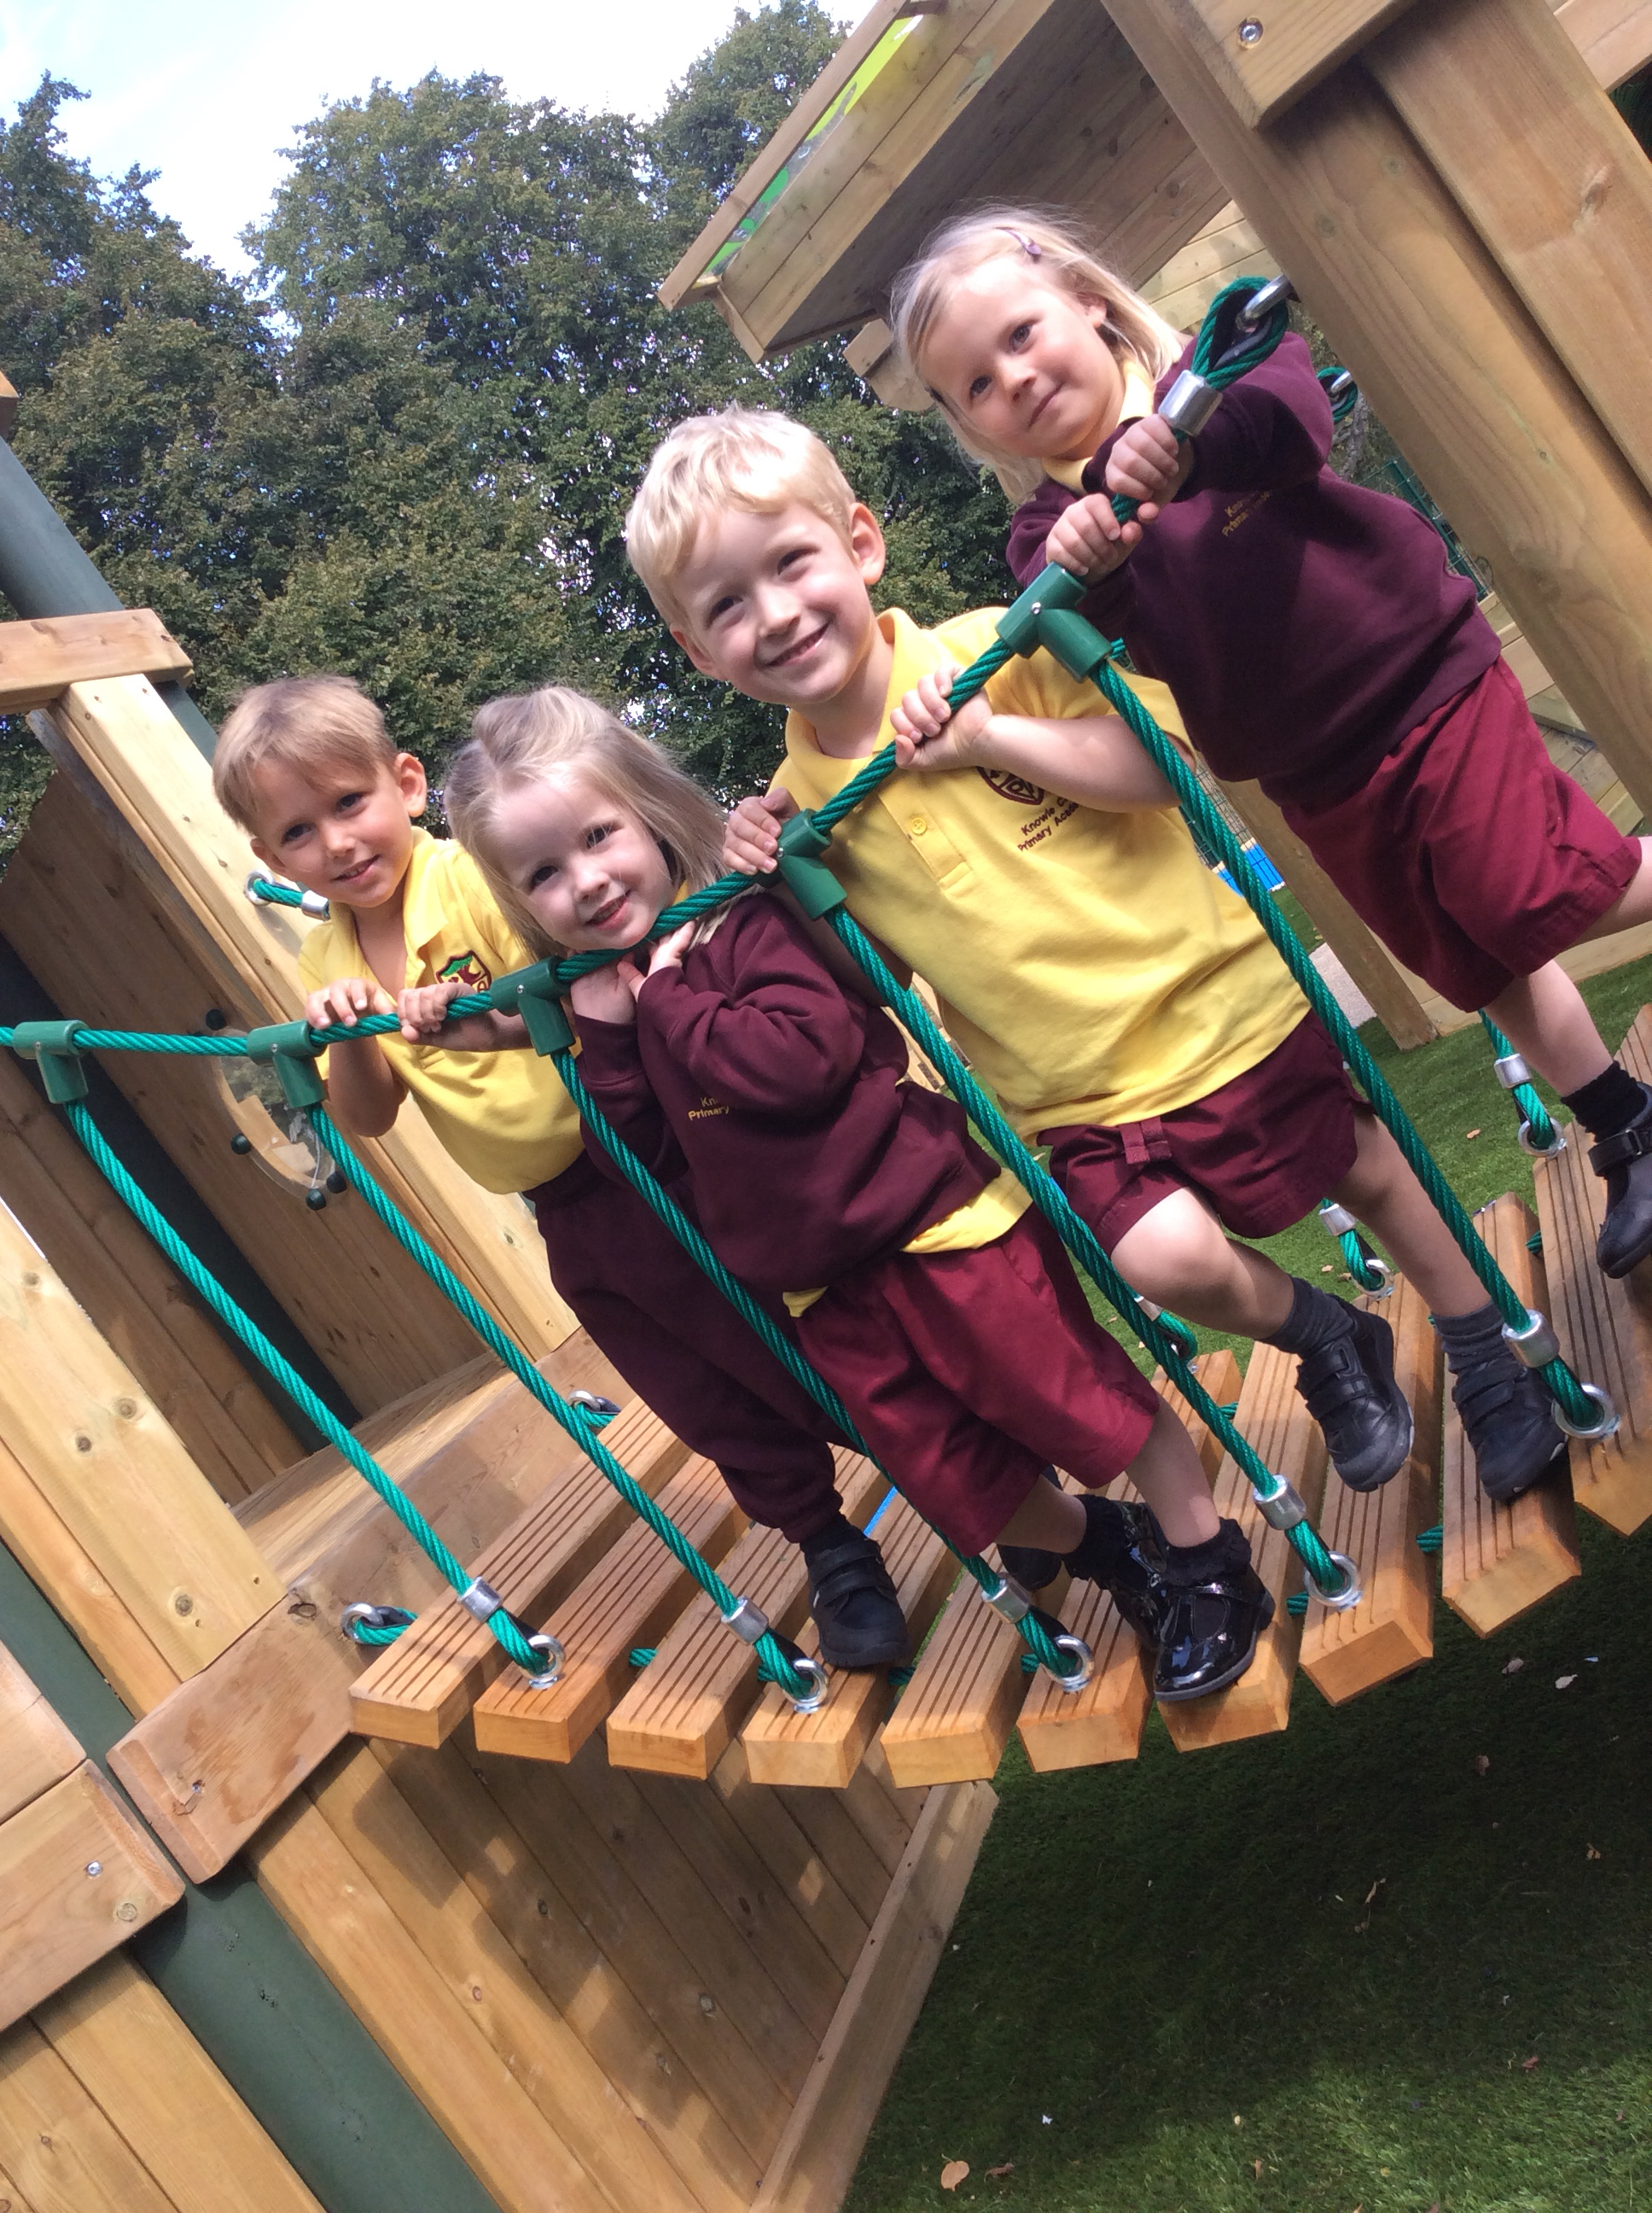
The Role of the Adult
The Facilitator ~ enables play to happen. They organise the environment, provide resources, adapt opportunities so that there is adaptations for each child and are on hand to respond to the needs of the children.
The Scaffolder ~ focuses on supporting the development of emerging skills. Scaffolding supports a child in their acquisition of skills from not being able to complete a task, to completing it with help, to eventually completing it on their own.

Slide 11
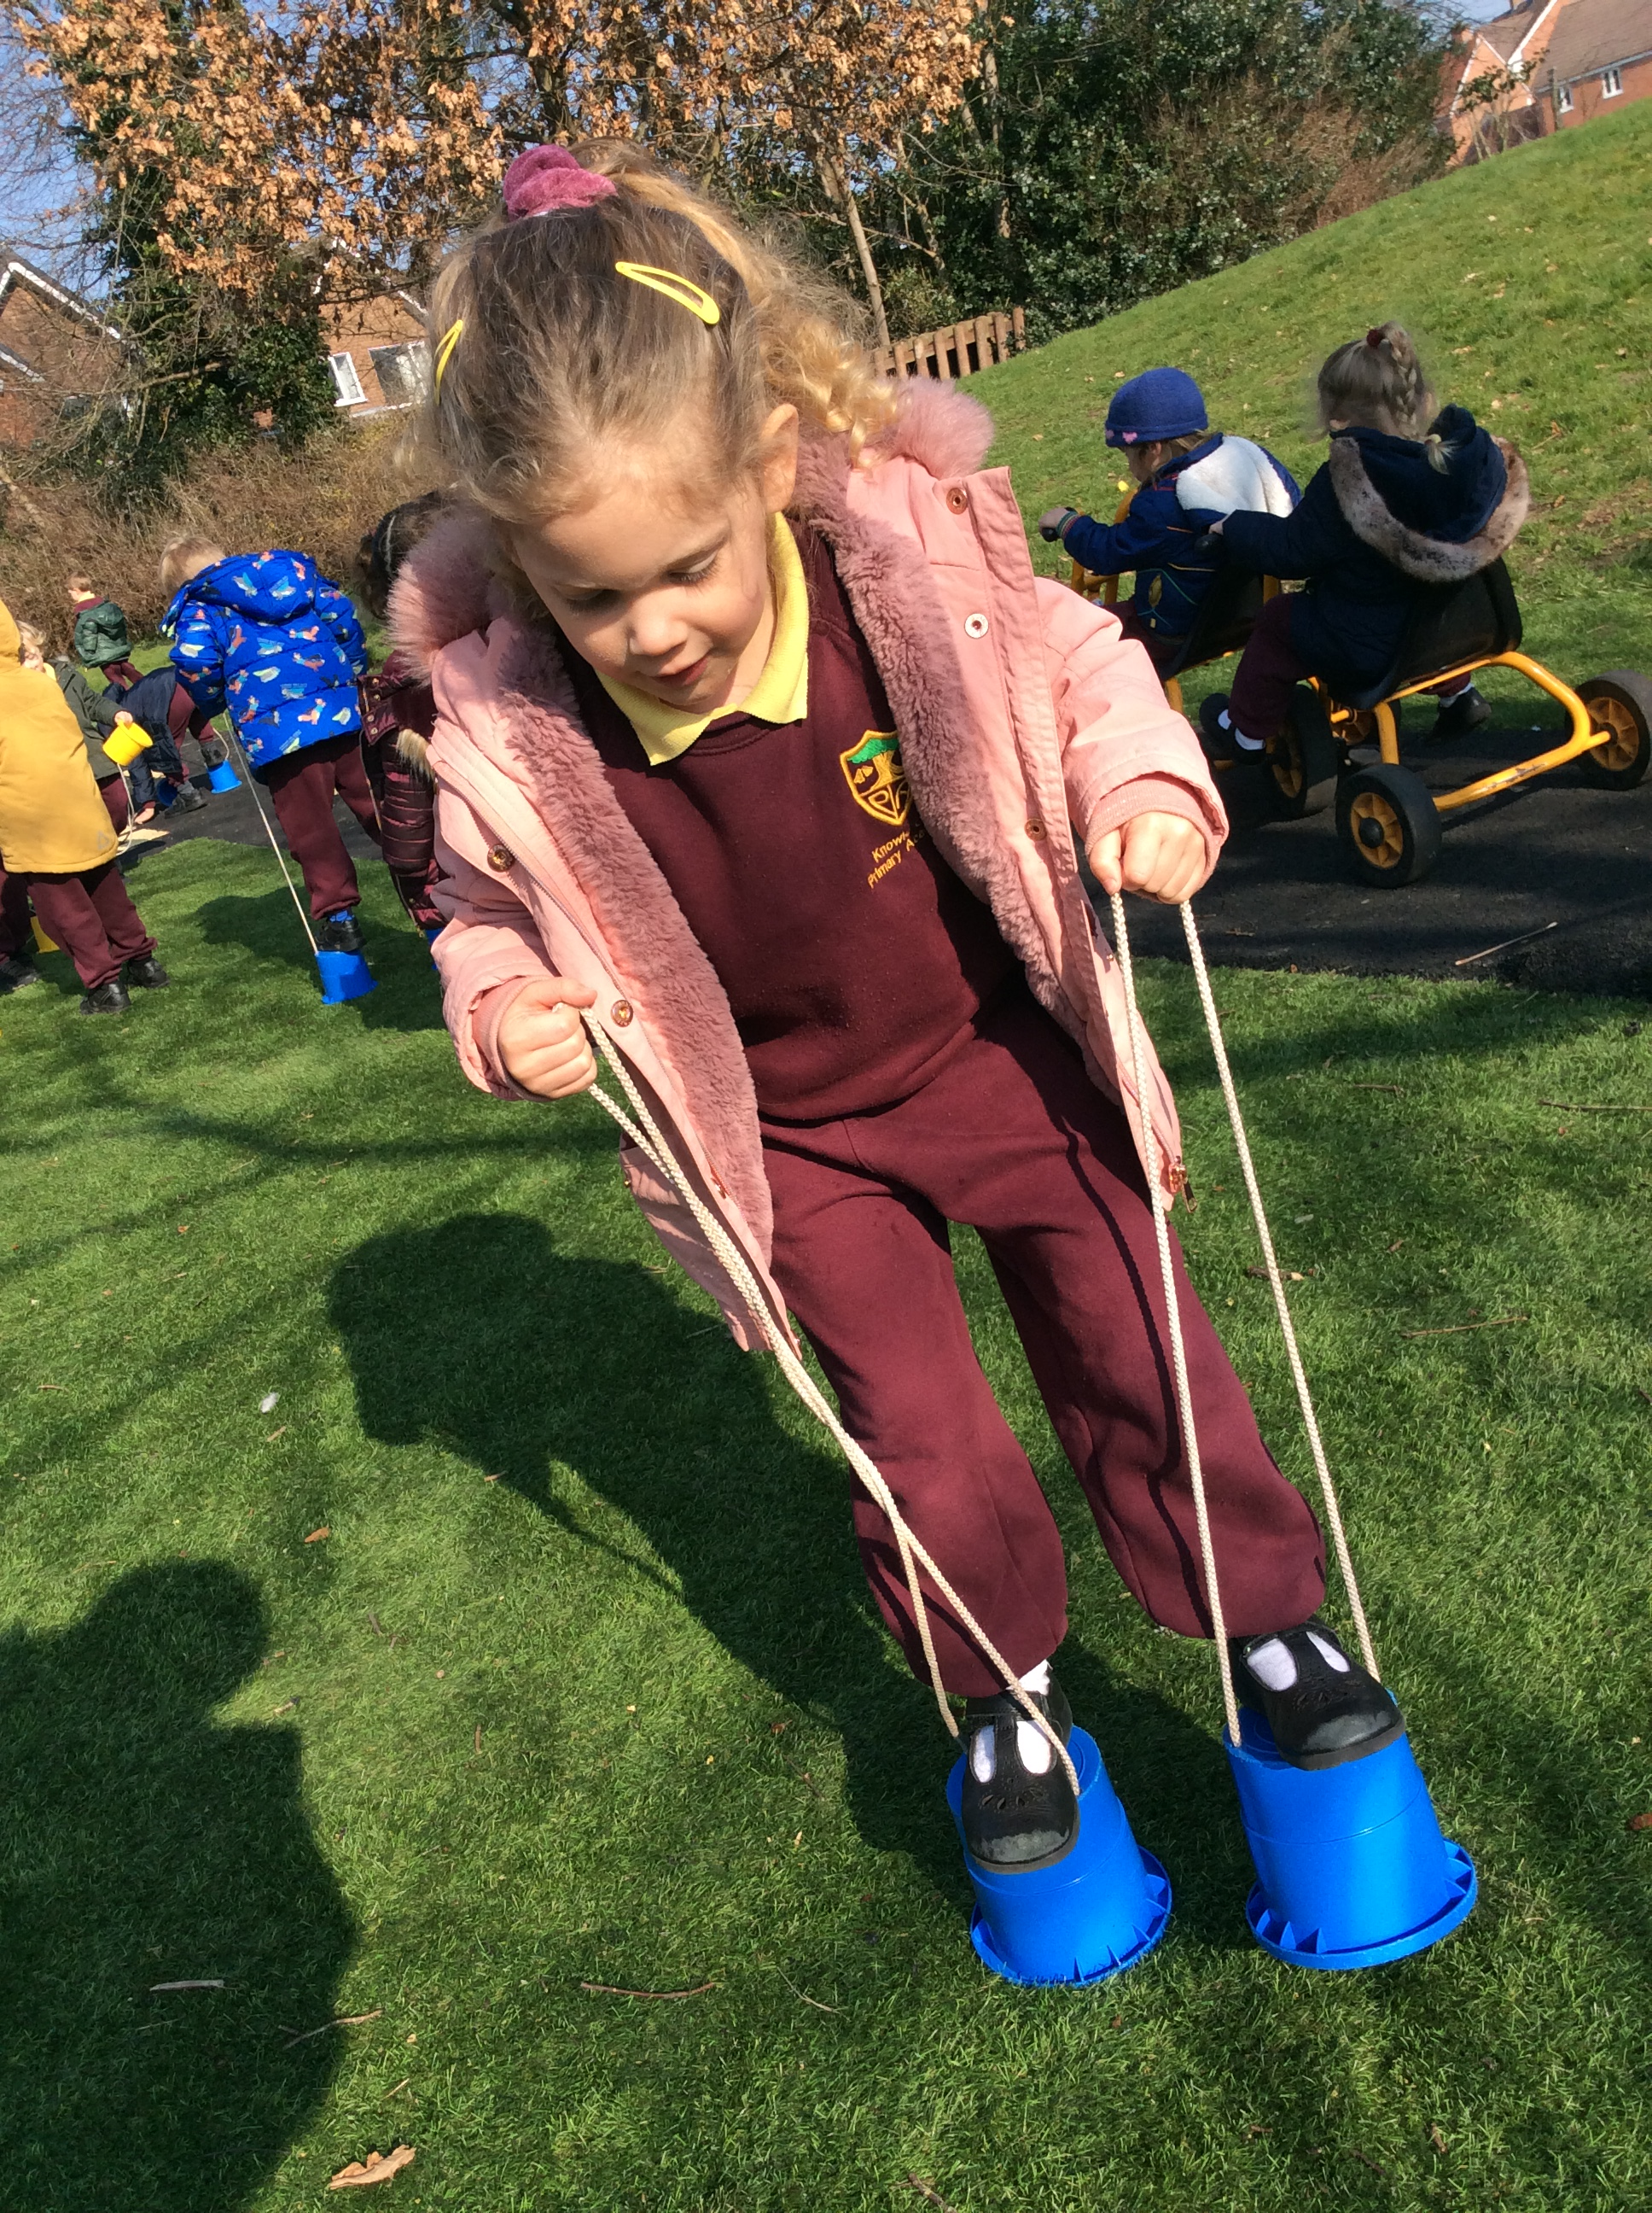
The Role of the Adult
The Teacher ~ the broad term used to describe the many different ways adults help children: It includes their interactions, modelling, explaining, recalling, demonstrating, encouraging, questioning, exploring, providing a narrative for what they are doing and setting challenges.
The Observer ~ when you take a step back and don’t facilitate the learning experiences you observe.

Slide 12
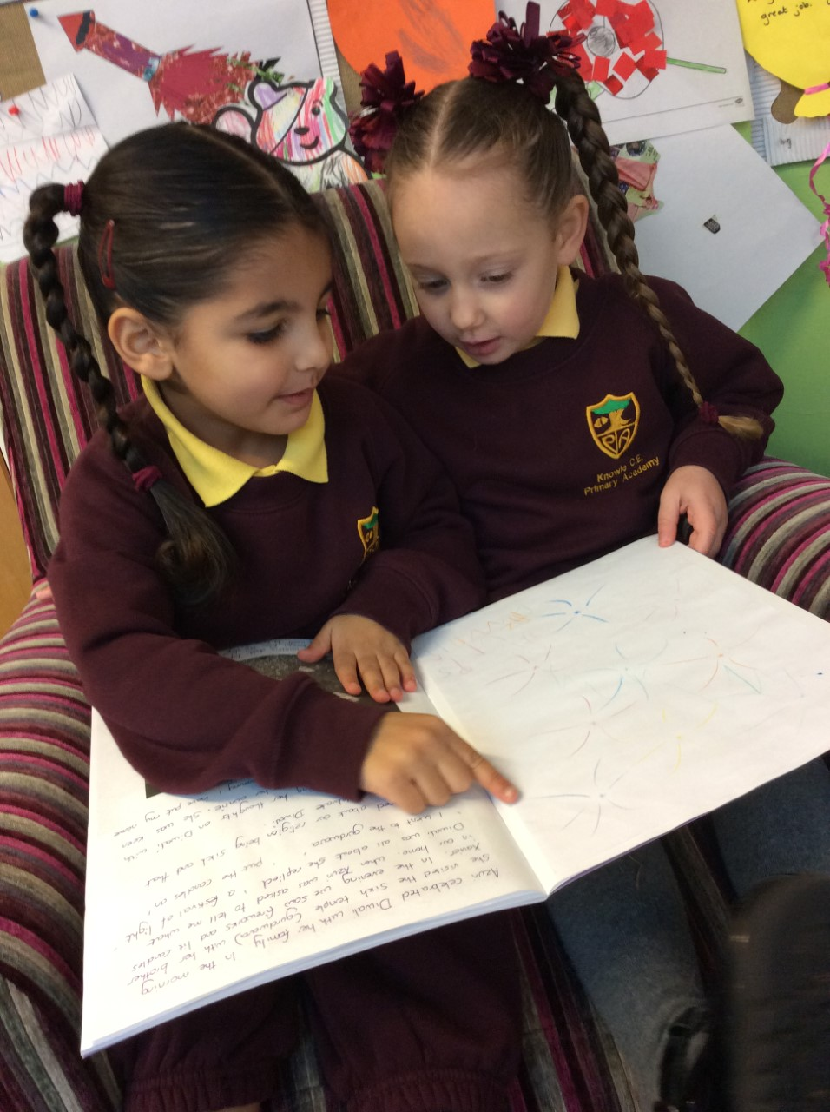
Communication and Language
The development of children’s spoken language underpins all seven areas of learning. The number and quality of conversations children have with adults in a language rich environment is crucial.
Building up vocabulary ~ (modelling, hands on experiences, conversation, echoing reading, story telling and role play)
Provide children with extensive opportunities to use and embed new words in a range of contexts.
Talk for Writing ~ During the initial ‘imitation’ stage children learn to retell a story off by heart. They retell a text with expression and actions and make use of a story map to support their retelling.

Slide 13
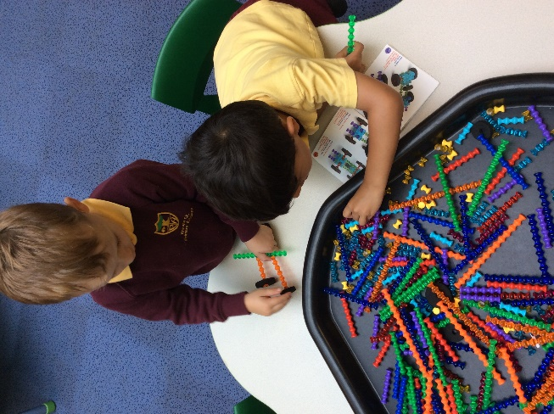
Personal, Social and Emotional Development
PSED is crucial for children to lead healthy and happy lives, and is fundamental to their cognitive development.
Developing strong, warm and supportive relationships with adults enable children to learn how to understand their own feelings and those of others.
Making relationships, co-operate and resolve conflicts
Children are supported to manage their emotions, develop a positive sense of self, set simple goals, have confidence in their own abilities, to persist and wait for what they want.
Looking after their bodies, healthy eating and managing personal needs independently.

Slide 14
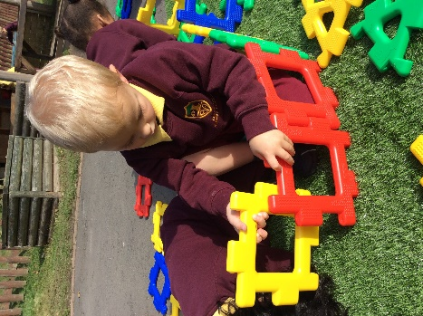
Physical Development
Every movement counts! Every time your child moves their brain builds connections.
Young children need lots of physical activity to develop their balance posture and coordination. These are the foundations that will help your child be physically ready to sit and concentrate.
Fine Motor Skills ~ threading, tweezers, cutting, play dough, jigsaw puzzles and construction. (Precision ~ hand eye-coordination, later linked to early literacy)
Gross Motor Skills ~ climbing, running, riding scooters and bicycles, balancing, developing their core strength.

Slide 15
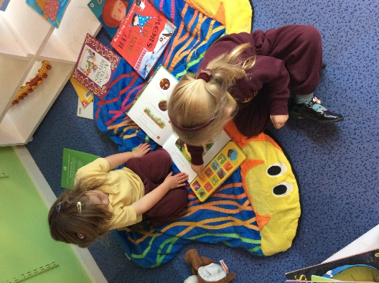
Literacy Development
Language comprehension
Necessary for both reading writing and only develops when adults talk about the world in which children live in and the books they read, songs and rhymes they sing together.
Skilled word reading
Taught later involves the decoding of unfamiliar words and the recognition of familiar words.
Understanding books
print, purpose (fiction/non-fiction), text, parts of a book, page sequencing.
Spot and suggest rhyme/syllables/initial sounds
Writing
Use some of their print and letter knowledge in early writing for example: writing a pretend shopping list or a card mummy writing a ‘m’ at the top of their page.
Write some or all of their name
Write some letter accurately

Slide 16
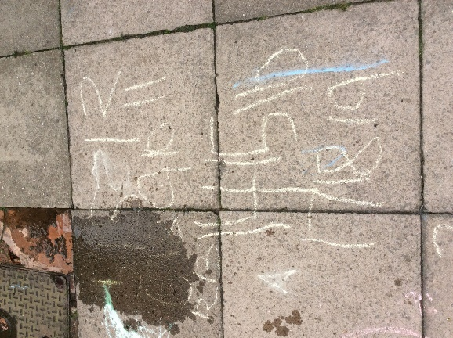
Mathematics Development
Number
Subitising to 3 objects (Subitising)
Recite numbers past 5
Show ‘finger numbers up to 5’
Link numerals and amounts
Experiment with their own symbols and marks as well as numerals
Compare quantities ‘more than’ ‘fewer than.’
Shape
Talk about and explore 2D and 3D shapes using mathematical vocabulary.
Select shapes for building
Combine shapes to make bigger ones

Slide 17
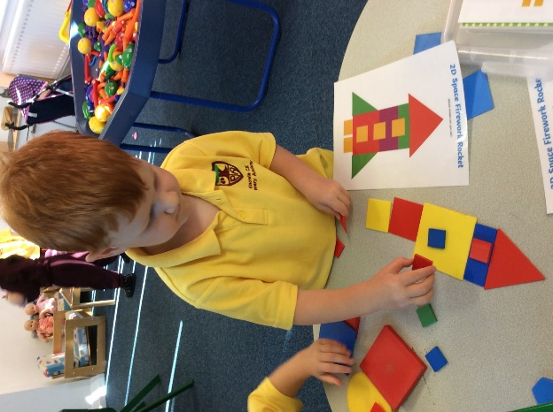
Mathematics Development
Position
Understand position through words alone
Describe a familiar route
Discuss the location of important places for example ‘Costa is next to the charity shop.’
Measure
- Make comparisons in relation to size, length, weight and capacity.

Slide 18
Nursery Themes
Autumn Term
~ Me in my Nursery ~ Festivals of Light
Muddy Monday Sessions
Harvest Festival (Design, making and testing our fruit salads)
Visit to the Church
Pumpkin Week
Remembrance Day
Diwali ~ WC 4th November
Bonfire Night
National Nursery Rhyme Week ~ 11th-15th November
Monday 11th November ~ Dress up as your favourite nursery rhyme character
Anti – Bullying Week ~ Odd Sock Day 11th – 15th November
Children in Need ~ 15th November
Nursery Nativity Carol Service ~ Monday 16th December

Slide 19
Nursery Themes
Spring Term
~ Brrr It’s Cold Outside ~ Here, There and Everywhere
Chinese New Year ~ 29th January
Transport Day ~ Dress up as a someone who uses a mode of transport for their job. ~ Monday 24th February
World Book Day ~ 6th March
Red Nose Day ~ 21st March
Mothering Sunday ~ 30th March
Car exploration
Special visits from professionals who use different modes of transport.
The Green Cross Code
Easter Week

Slide 20
Nursery Themes
Summer Term
~ All Creatures Great and Small ~ Once upon a time…
Dress up as an animal day ~ Monday 8th April
Angela's Animal Antics Visit
Ellie the dog visit
Welcoming and looking after our new Nursery pets
Family story time visits
Story time workshop/live performance
Sports Day ~ Monday 1st July (Reserve dates 2nd/3rd)
Transition to Reception
Celebrating our time in Nursery ~ Graduation

Slide 21
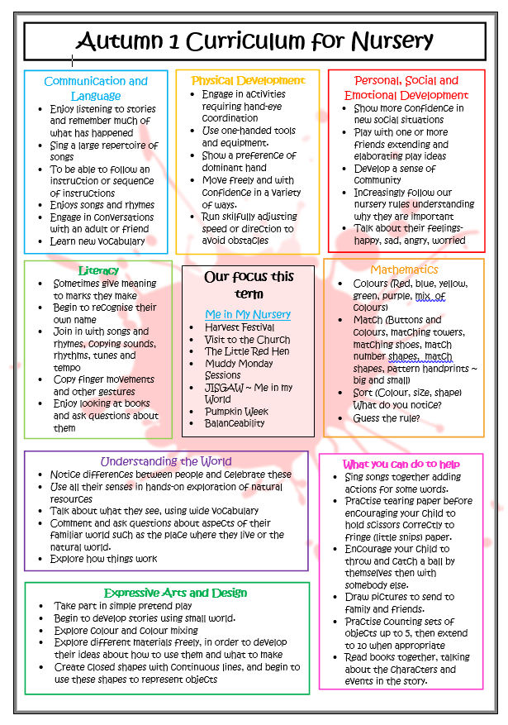
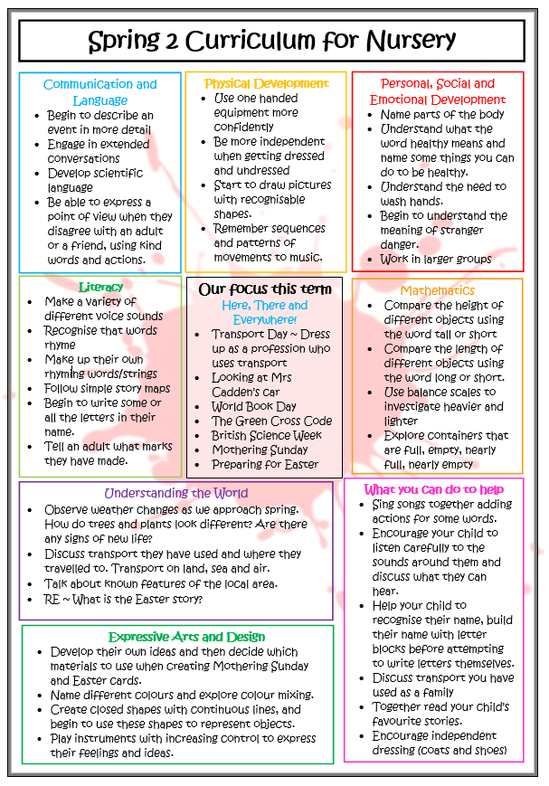
Curriculum Newsletter

Slide 22
Parental Involvement
WOW Moment Books
Provide you with the opportunity to contribute to your child’s learning journey, as they travel through the school year. Each half term we ask you to focus on one area of learning.
They aim to complement the achievements we see your child make in school and give you the opportunity to share how they show you their learning at home.
It will also provide you with a lovely record of all those momentous and ‘WOW’ moments that your child has conquered as they grow and learn new things.
Wow books will be sent home this Friday 25th October and collected just before the end of next half term.

Slide 23
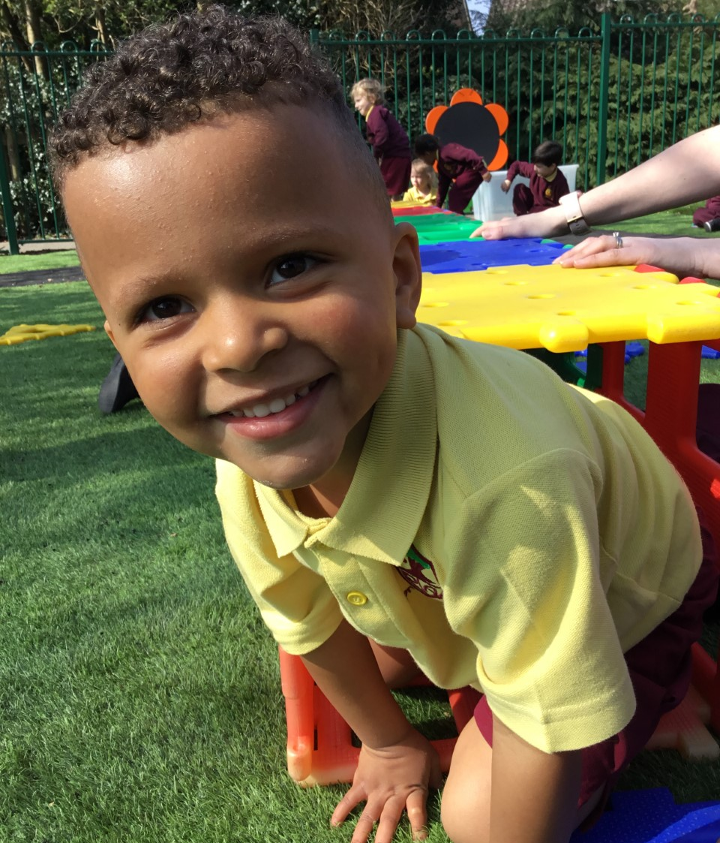
Special Balloons
These balloons can be used to record any special moments that happen at home. These may include sleeping in their own bed, brushing their teeth, writing some letters for the first time, helping around the house, riding a bike or getting themselves dressed in the morning. Whatever it is we would love to hear about it.
Special balloons will be shared in your child’s key worker group and will placed on to their learning board before being put into the children’s scrapbooks.

Slide 24
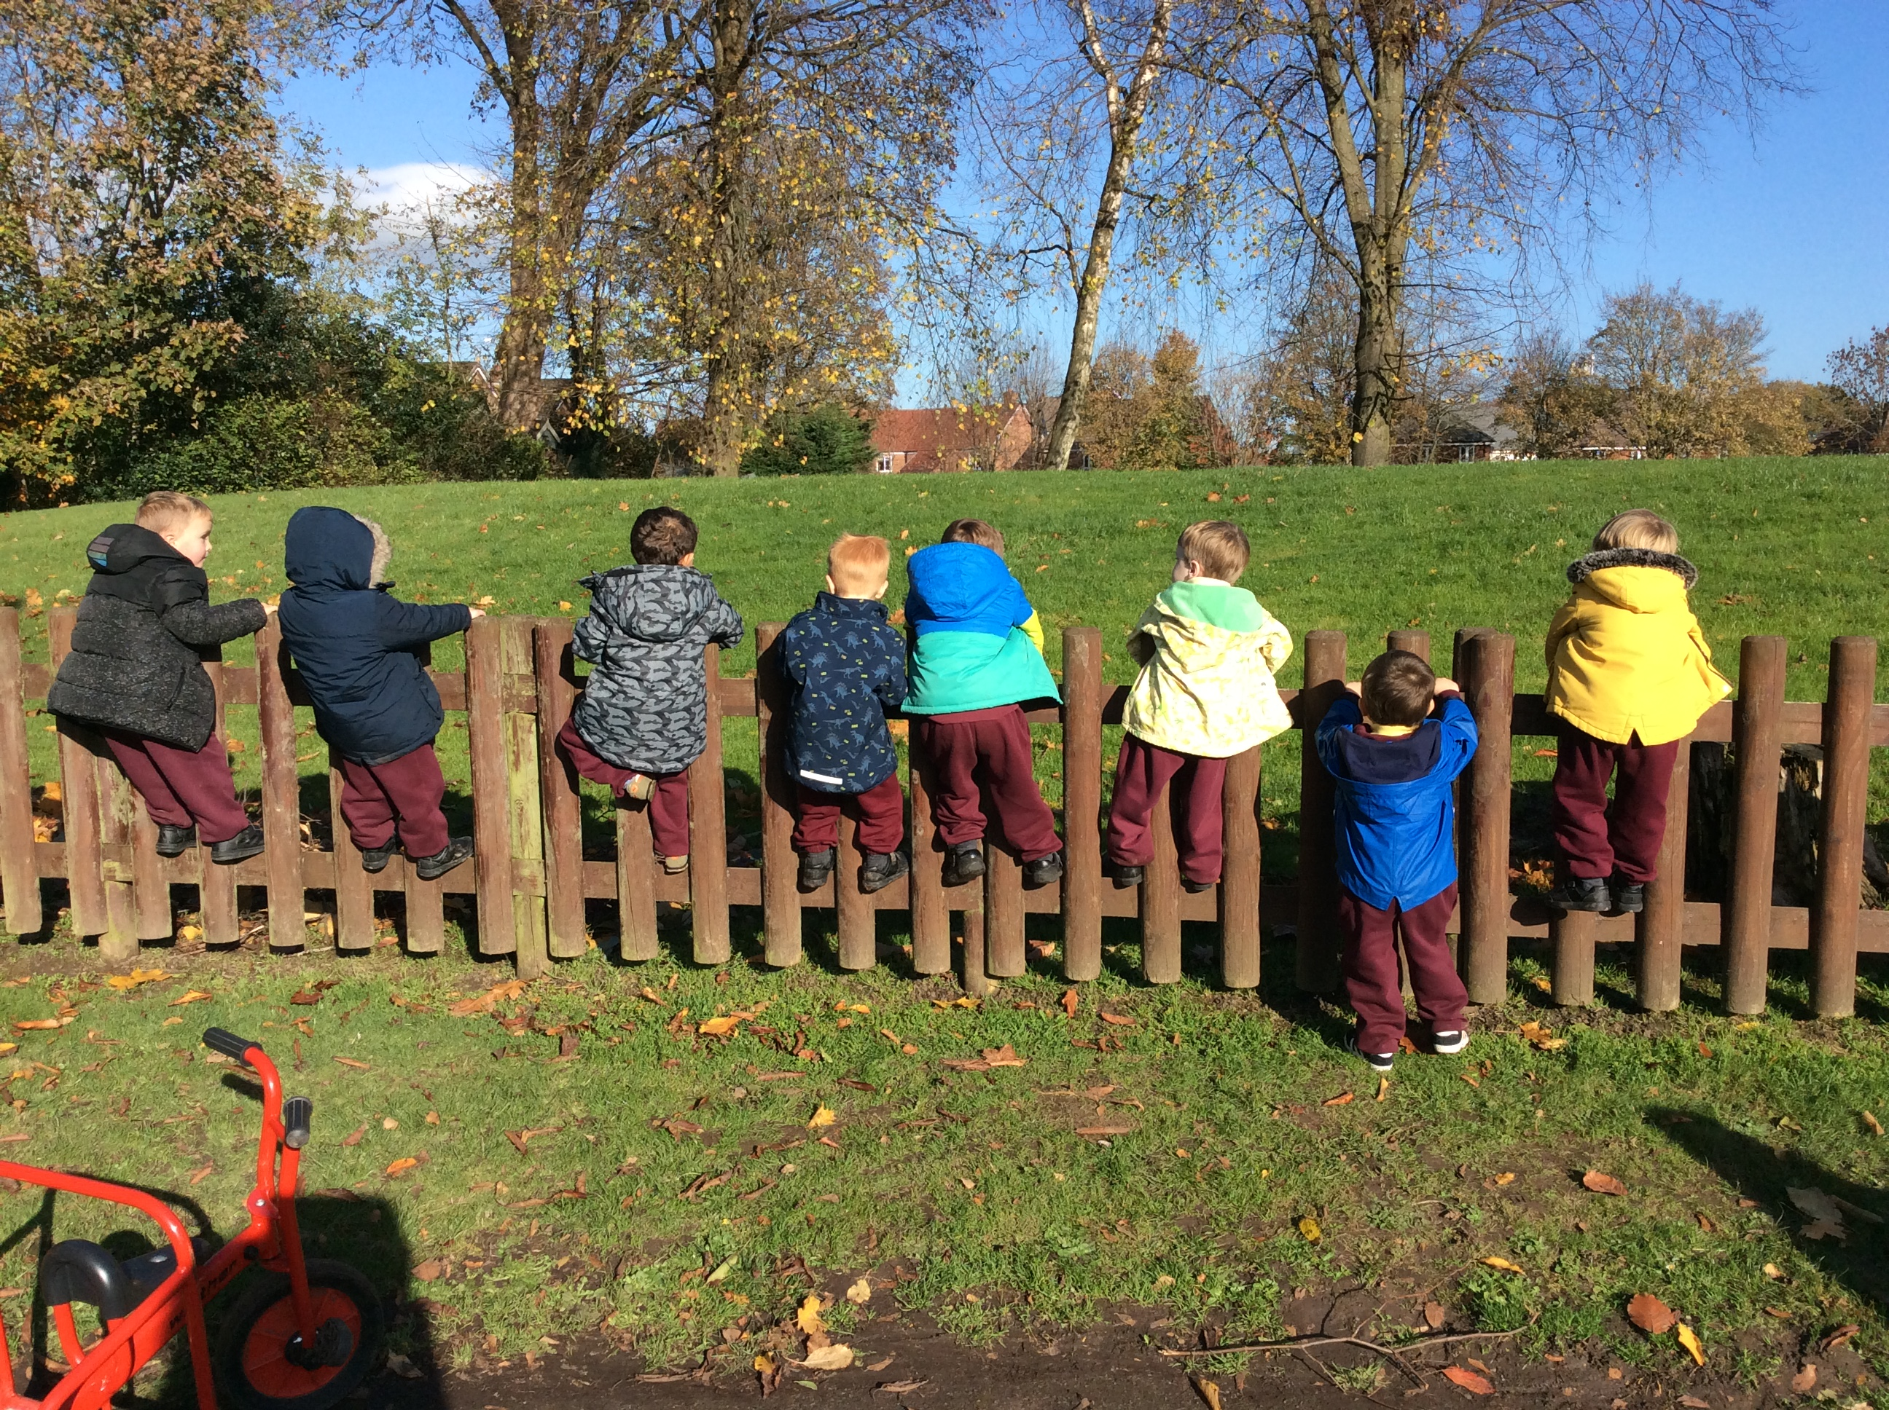
Thank You

